Slide 1

IAM in National Decarbonization Pathways
PLCY-798K
Integrated Human-Earth System Modeling and Policy Assessment
April 1, 2023

Slide 2
Key questions being asked in national contexts
Research/policy questions
Deep decarbonization pathways
Sectoral specific transitions to a low-carbon energy system
Impacts of specific policies
Societal implications
Air quality/health
Employment, just transition
Economic growth, etc.
Climate change impacts
Stakeholders
Governments: policy and science offices
Business
NGOs
How to inform decision making
Tools: different tools / combinations of tools can be applied depending on research question

Slide 3

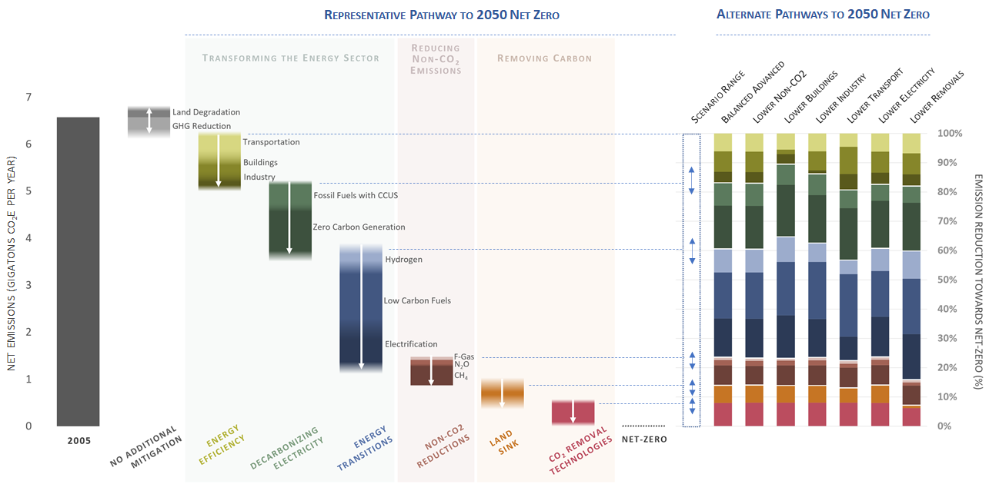
The U.S. Long-Term Strategy

Slide 4
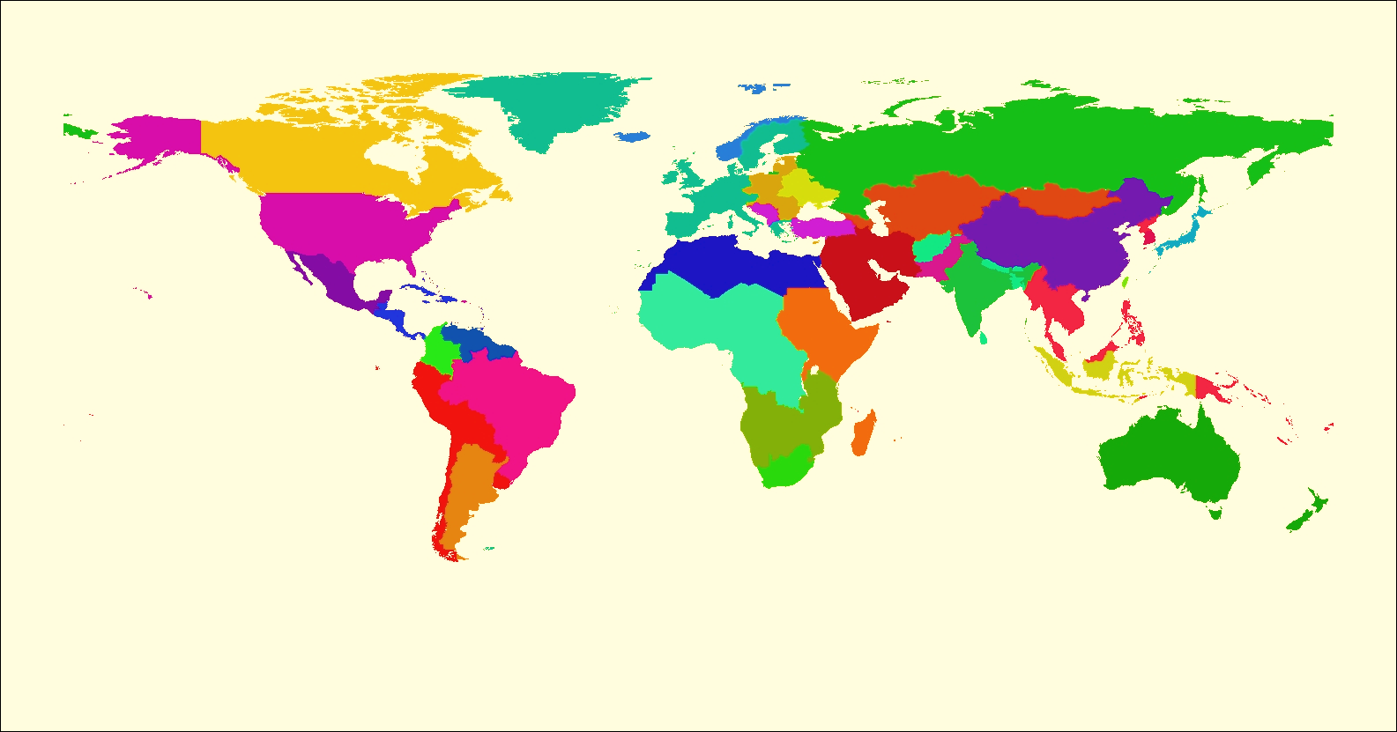
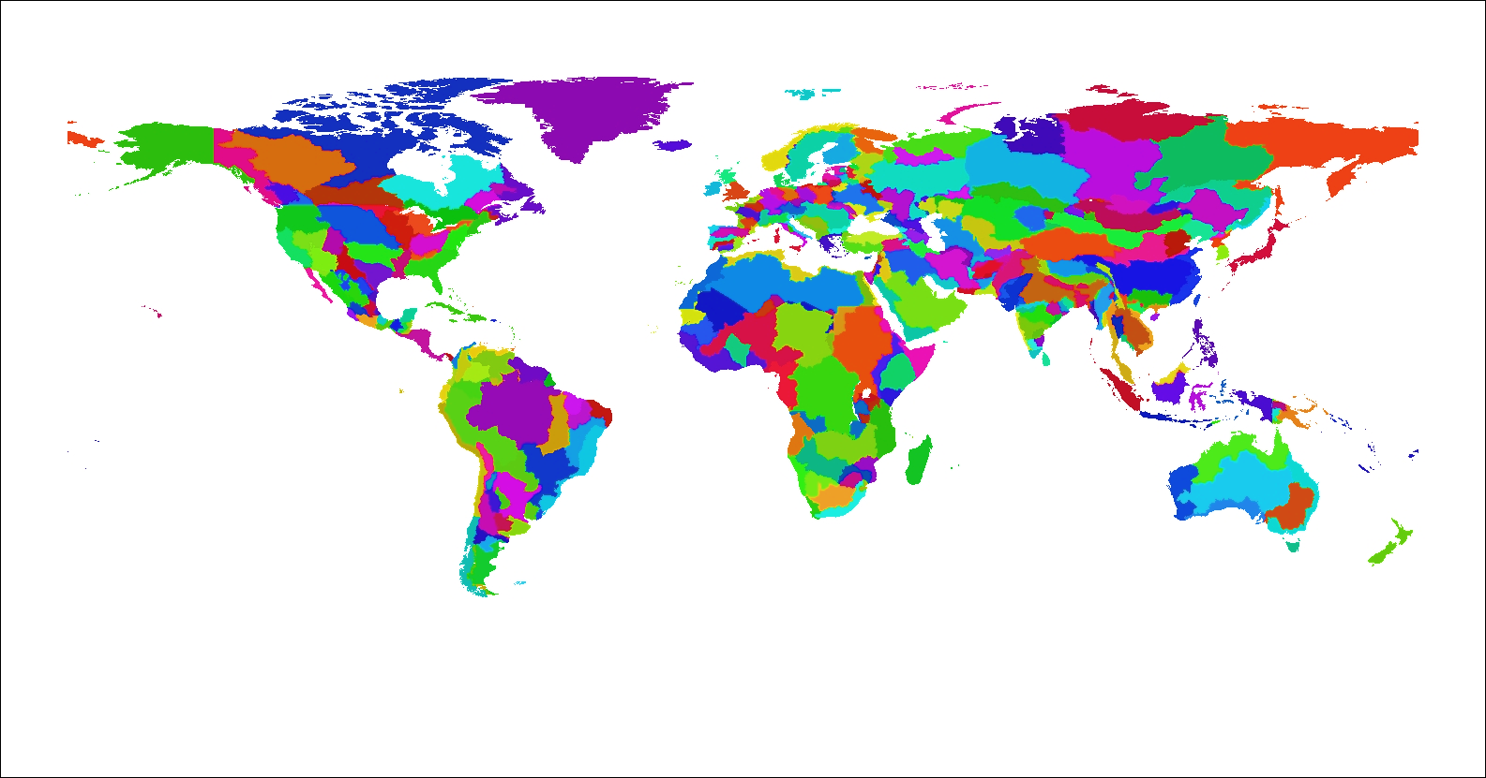
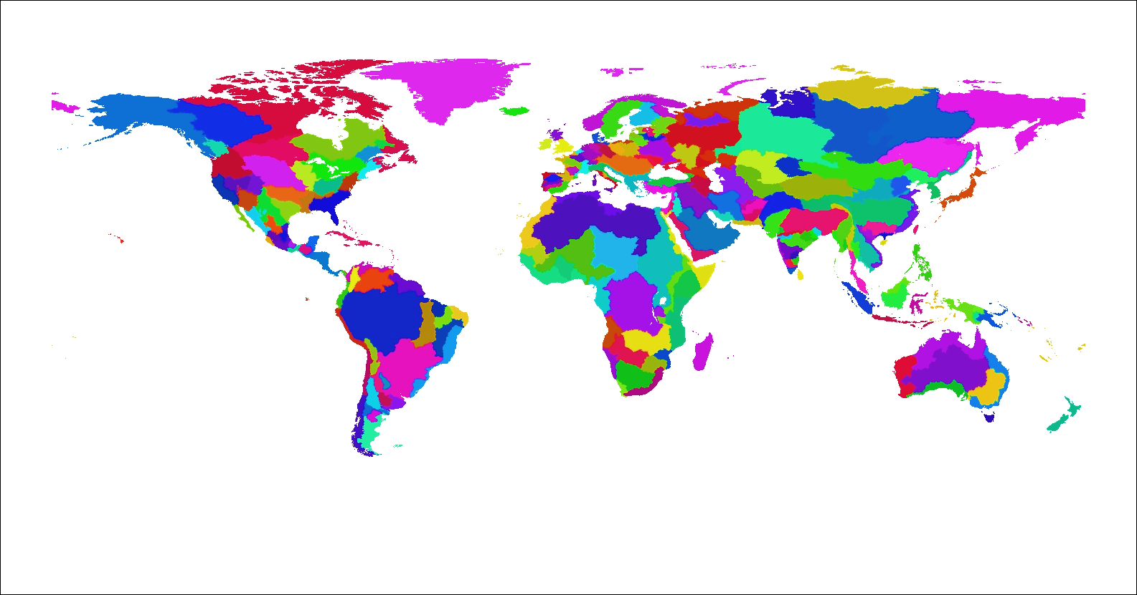




Global Change Analysis Model
Model Coverage
GCAM is a global hierarchical equilibrium integrated assessment model
GCAM links Economic, Energy, Land-use, Water, and Climate systems in a technology-rich model
Runs to 2100 in 5-year time-steps
Emissions of 16 greenhouse gases (GHG) and air pollutants are tracked
GCAM is natively coupled to a simple climate model HECTOR, but can also be coupled to Energy Exascale Earth System Model (E3SM)
GCAM is a community model, download link and documentation available at: http://jgcri.github.io/gcam-doc/toc.html
GCAM is primarily developed with support from Office of Science, but has wide reaching applications in policy, science, and philanthropies
32 Energy & Economy Regions
384 Land Regions
235 Water Basins
4

Slide 5
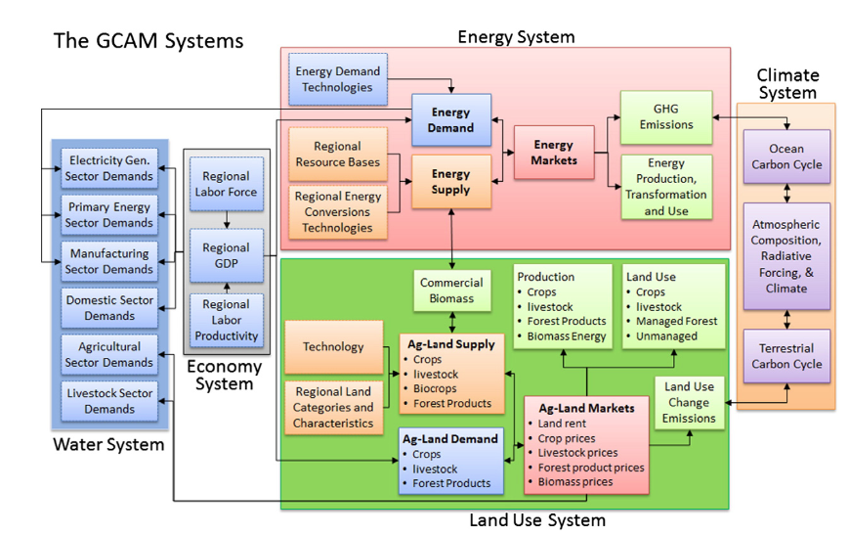
Global Change Analysis Model
Image source: Hejazi, M. et al. Long-term global water projections using six socioeconomic scenarios in an integrated assessment modeling framework. Technol. Forecast. Soc. Change 81, 205–226 (2014).

Slide 6
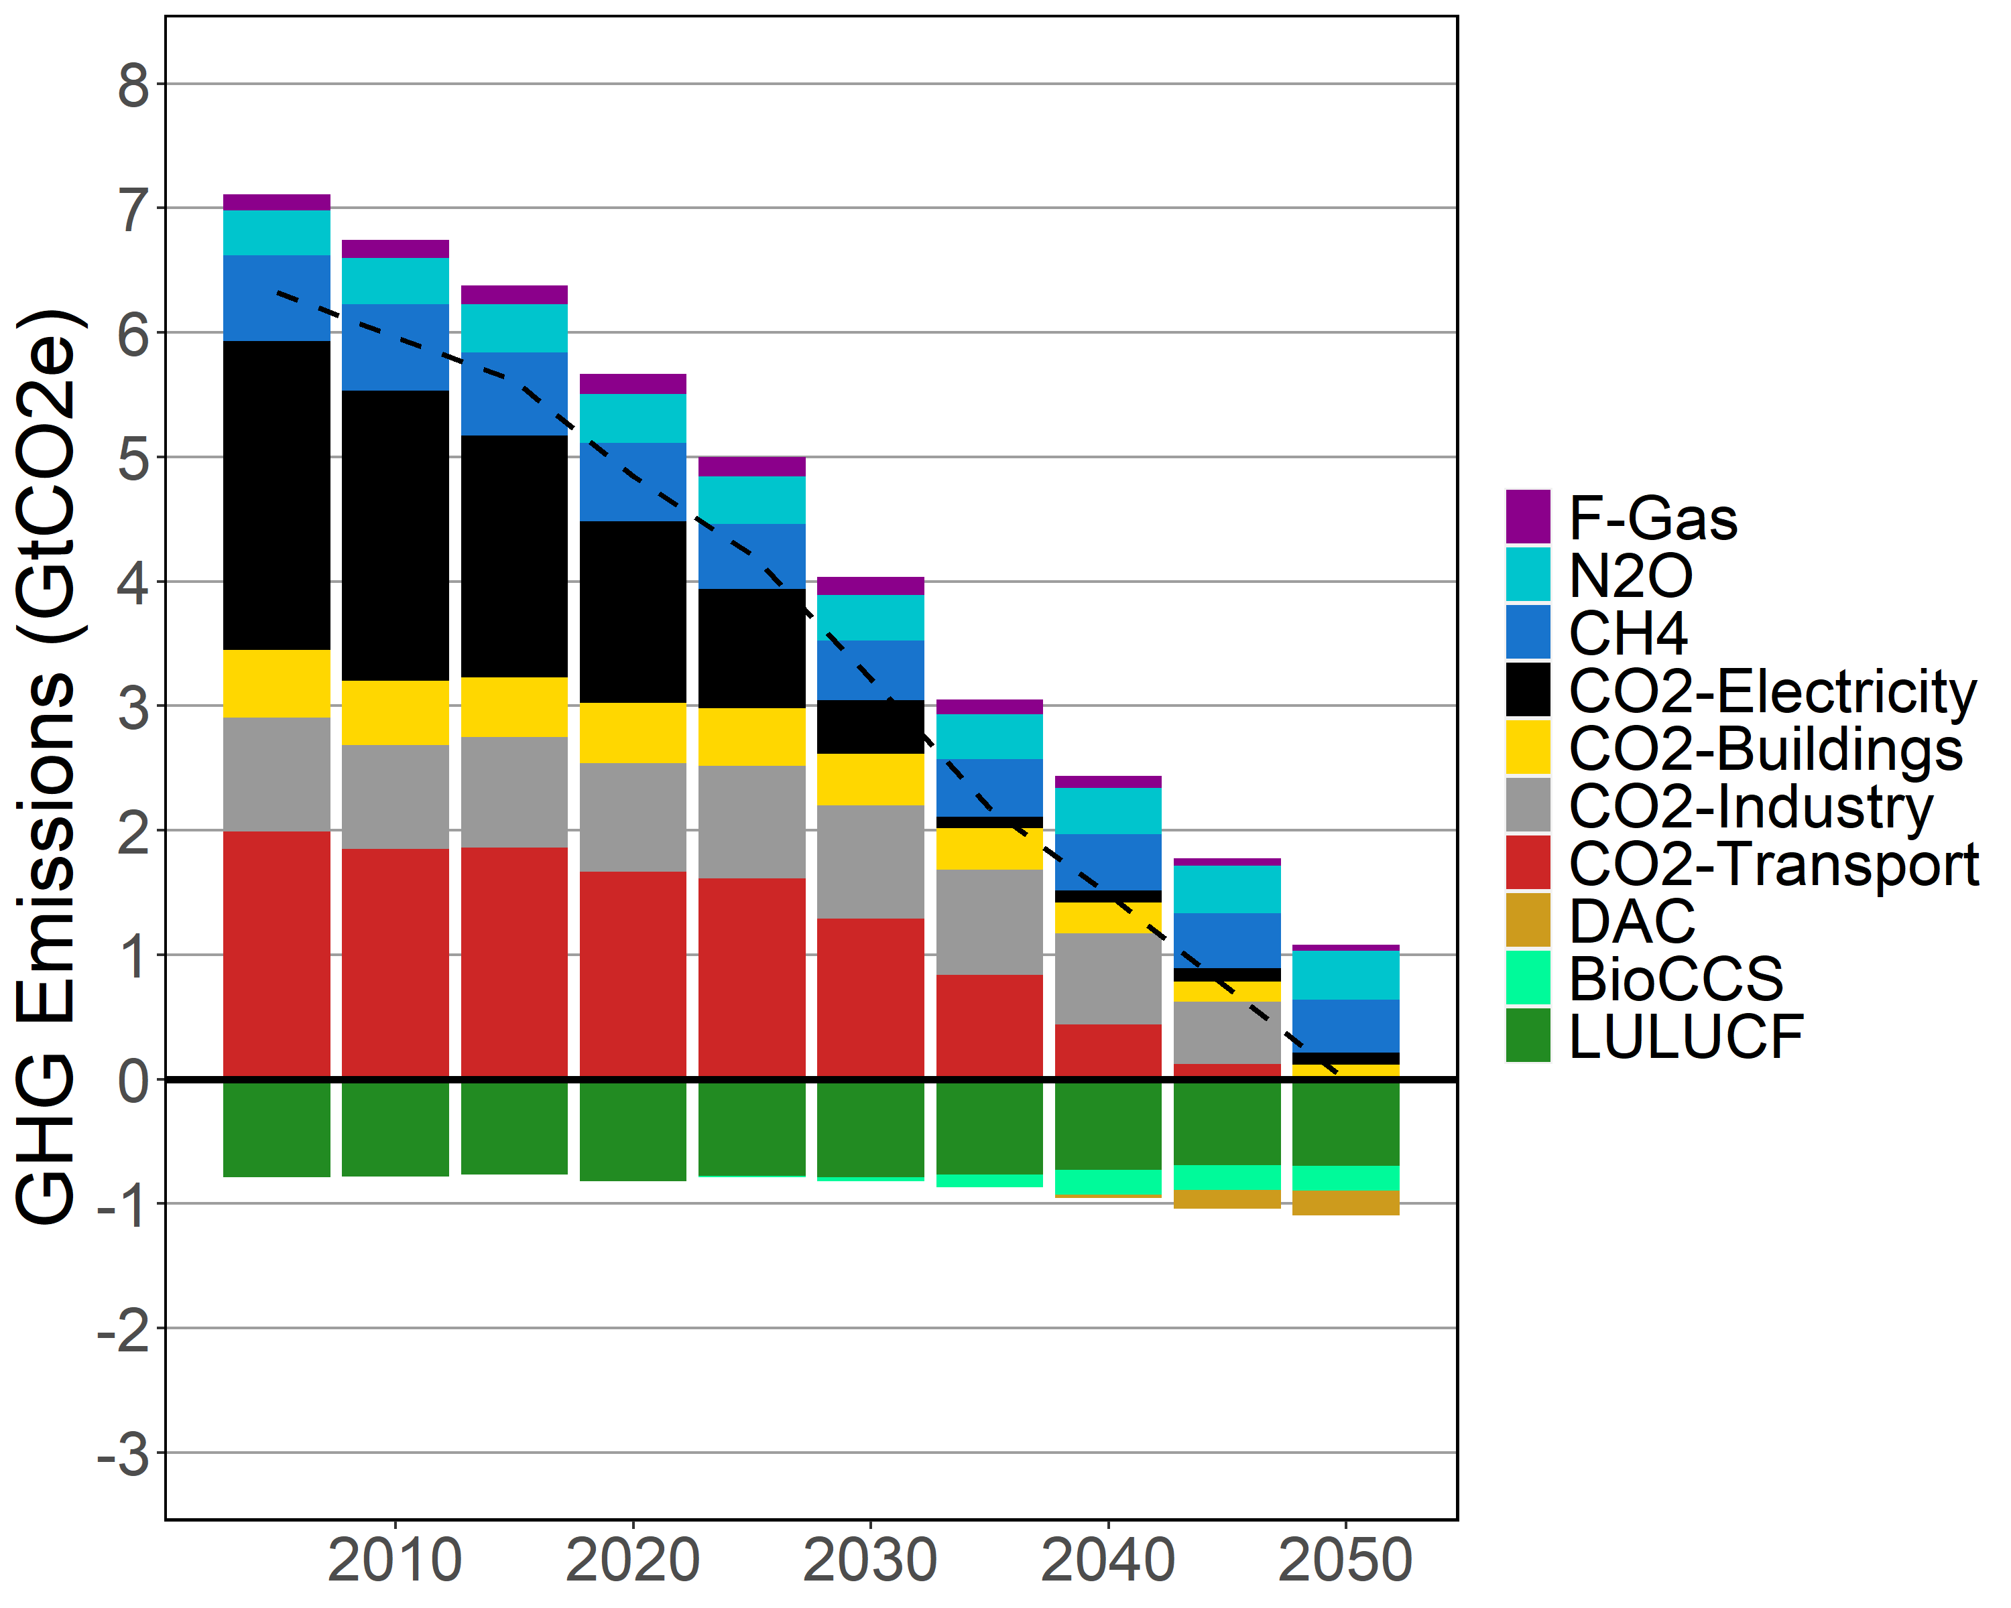
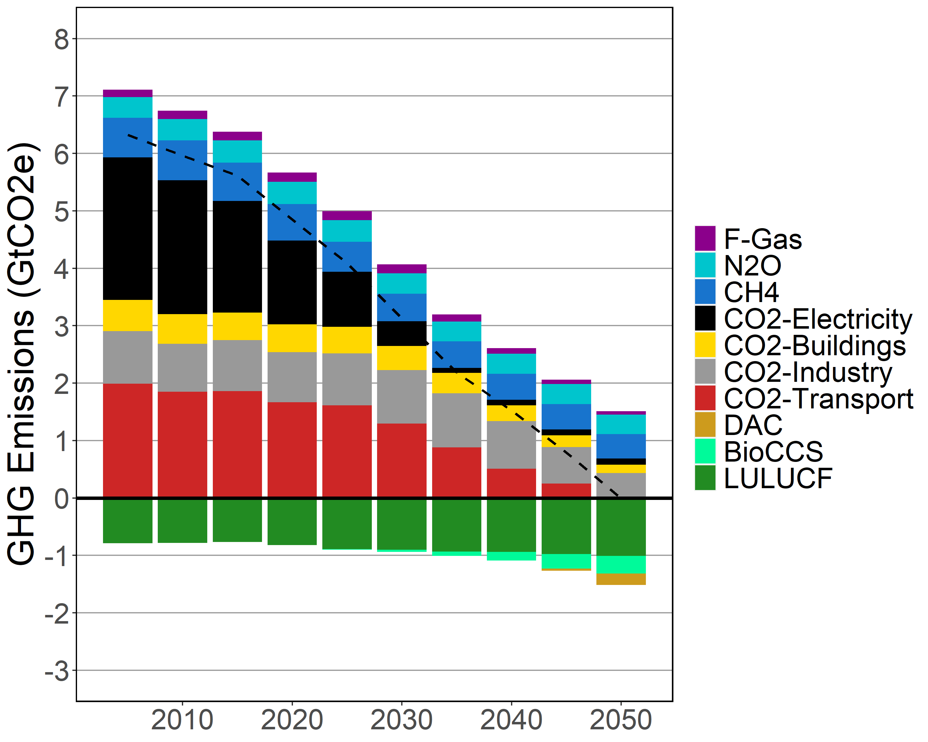
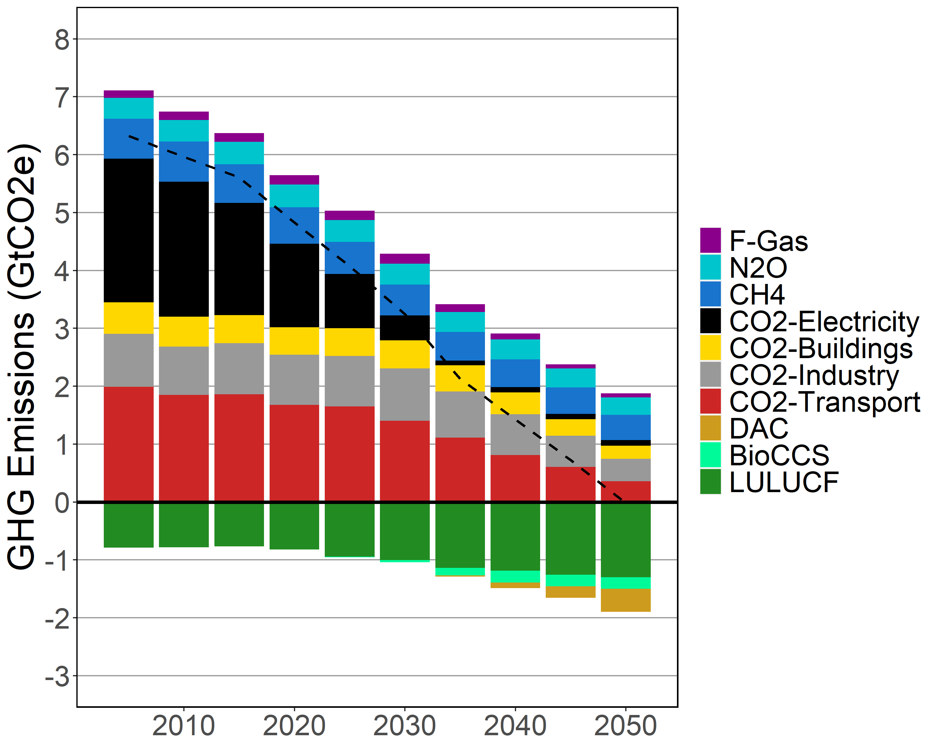
GHG Emissions
Low CDR Med CDR High CDR
+ High Energy Demand

Slide 7
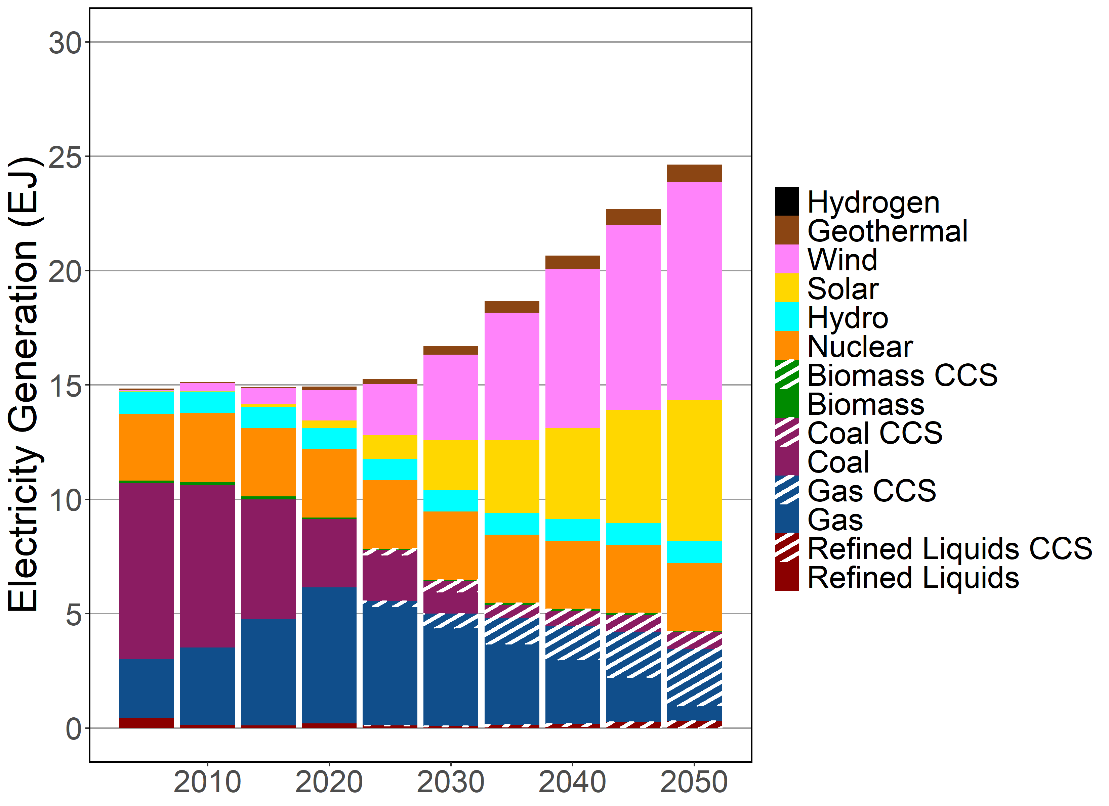
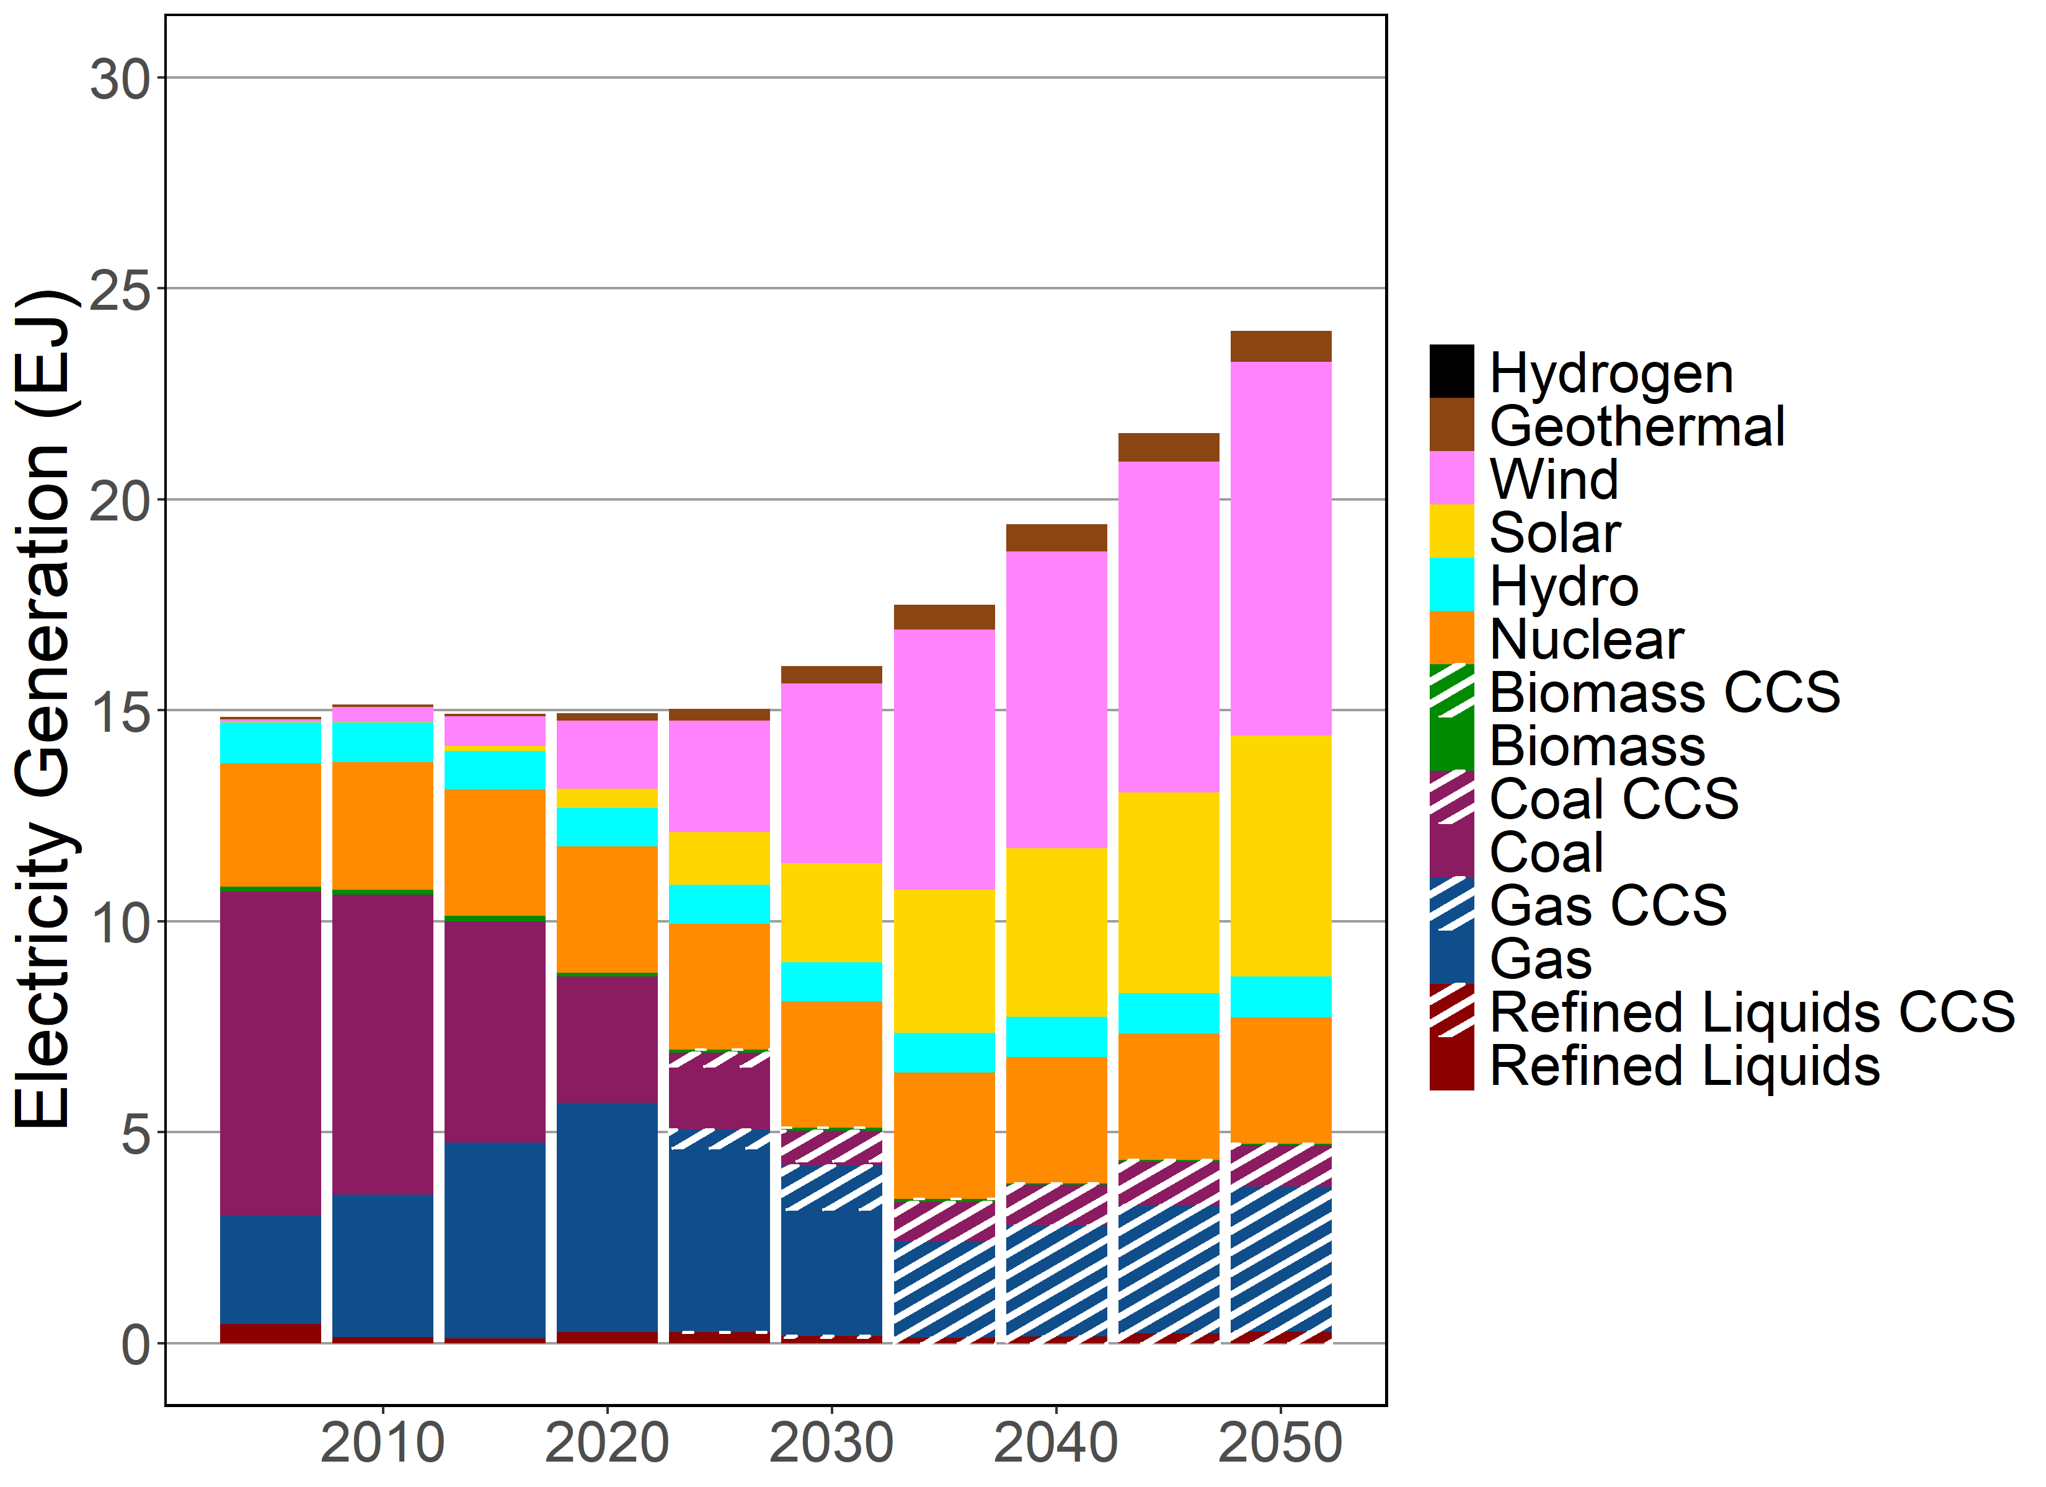
Electricity Generation
Standard Elec Advanced Elec

Slide 8
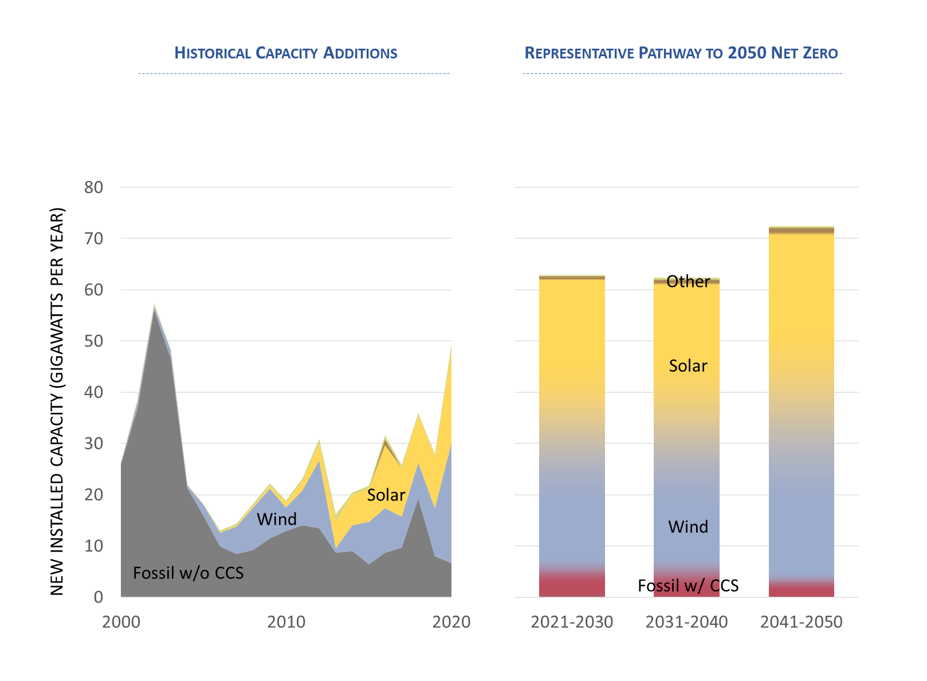
Power Sector Transition

Slide 9
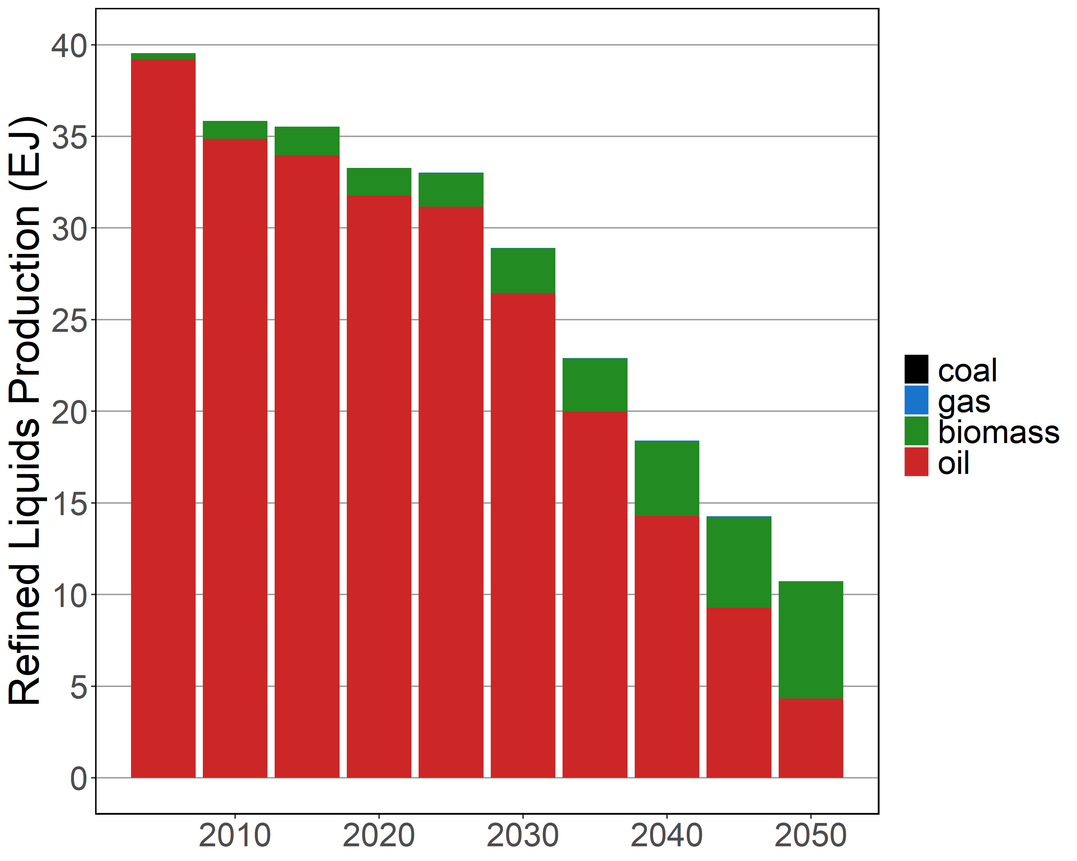
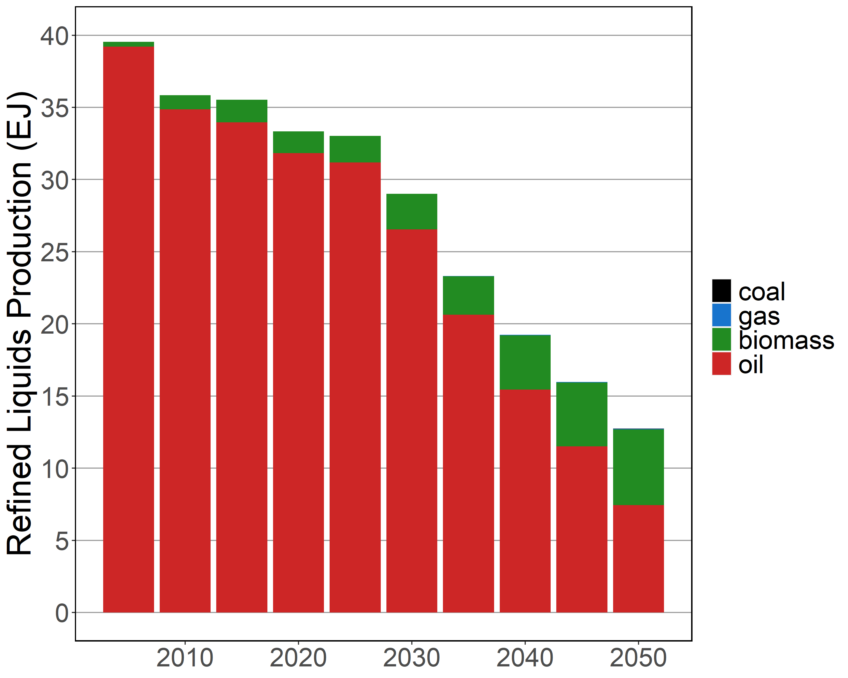
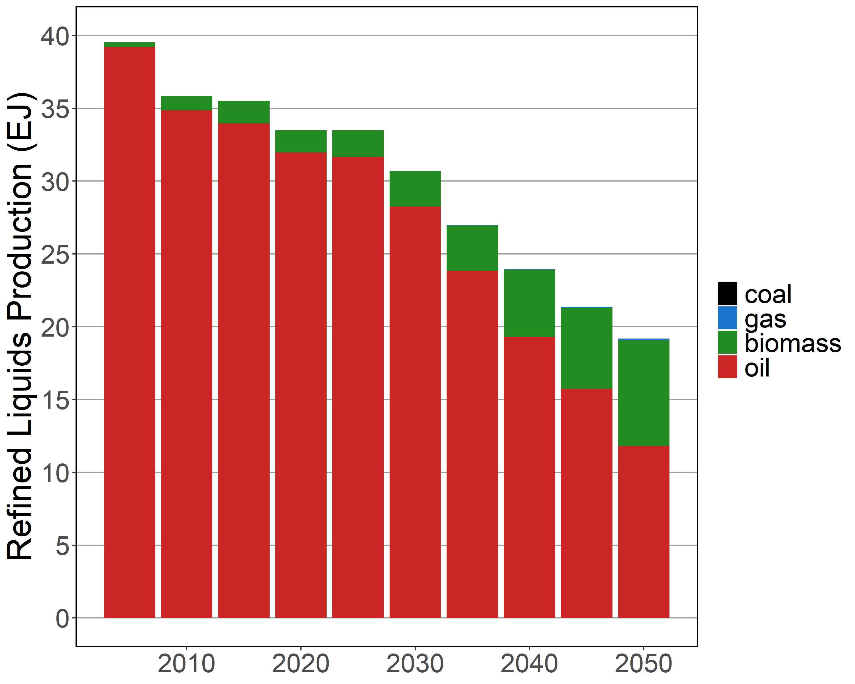
Refined Liquids Production
Low CDR Med CDR High CDR
+ High Energy Demand

Slide 10
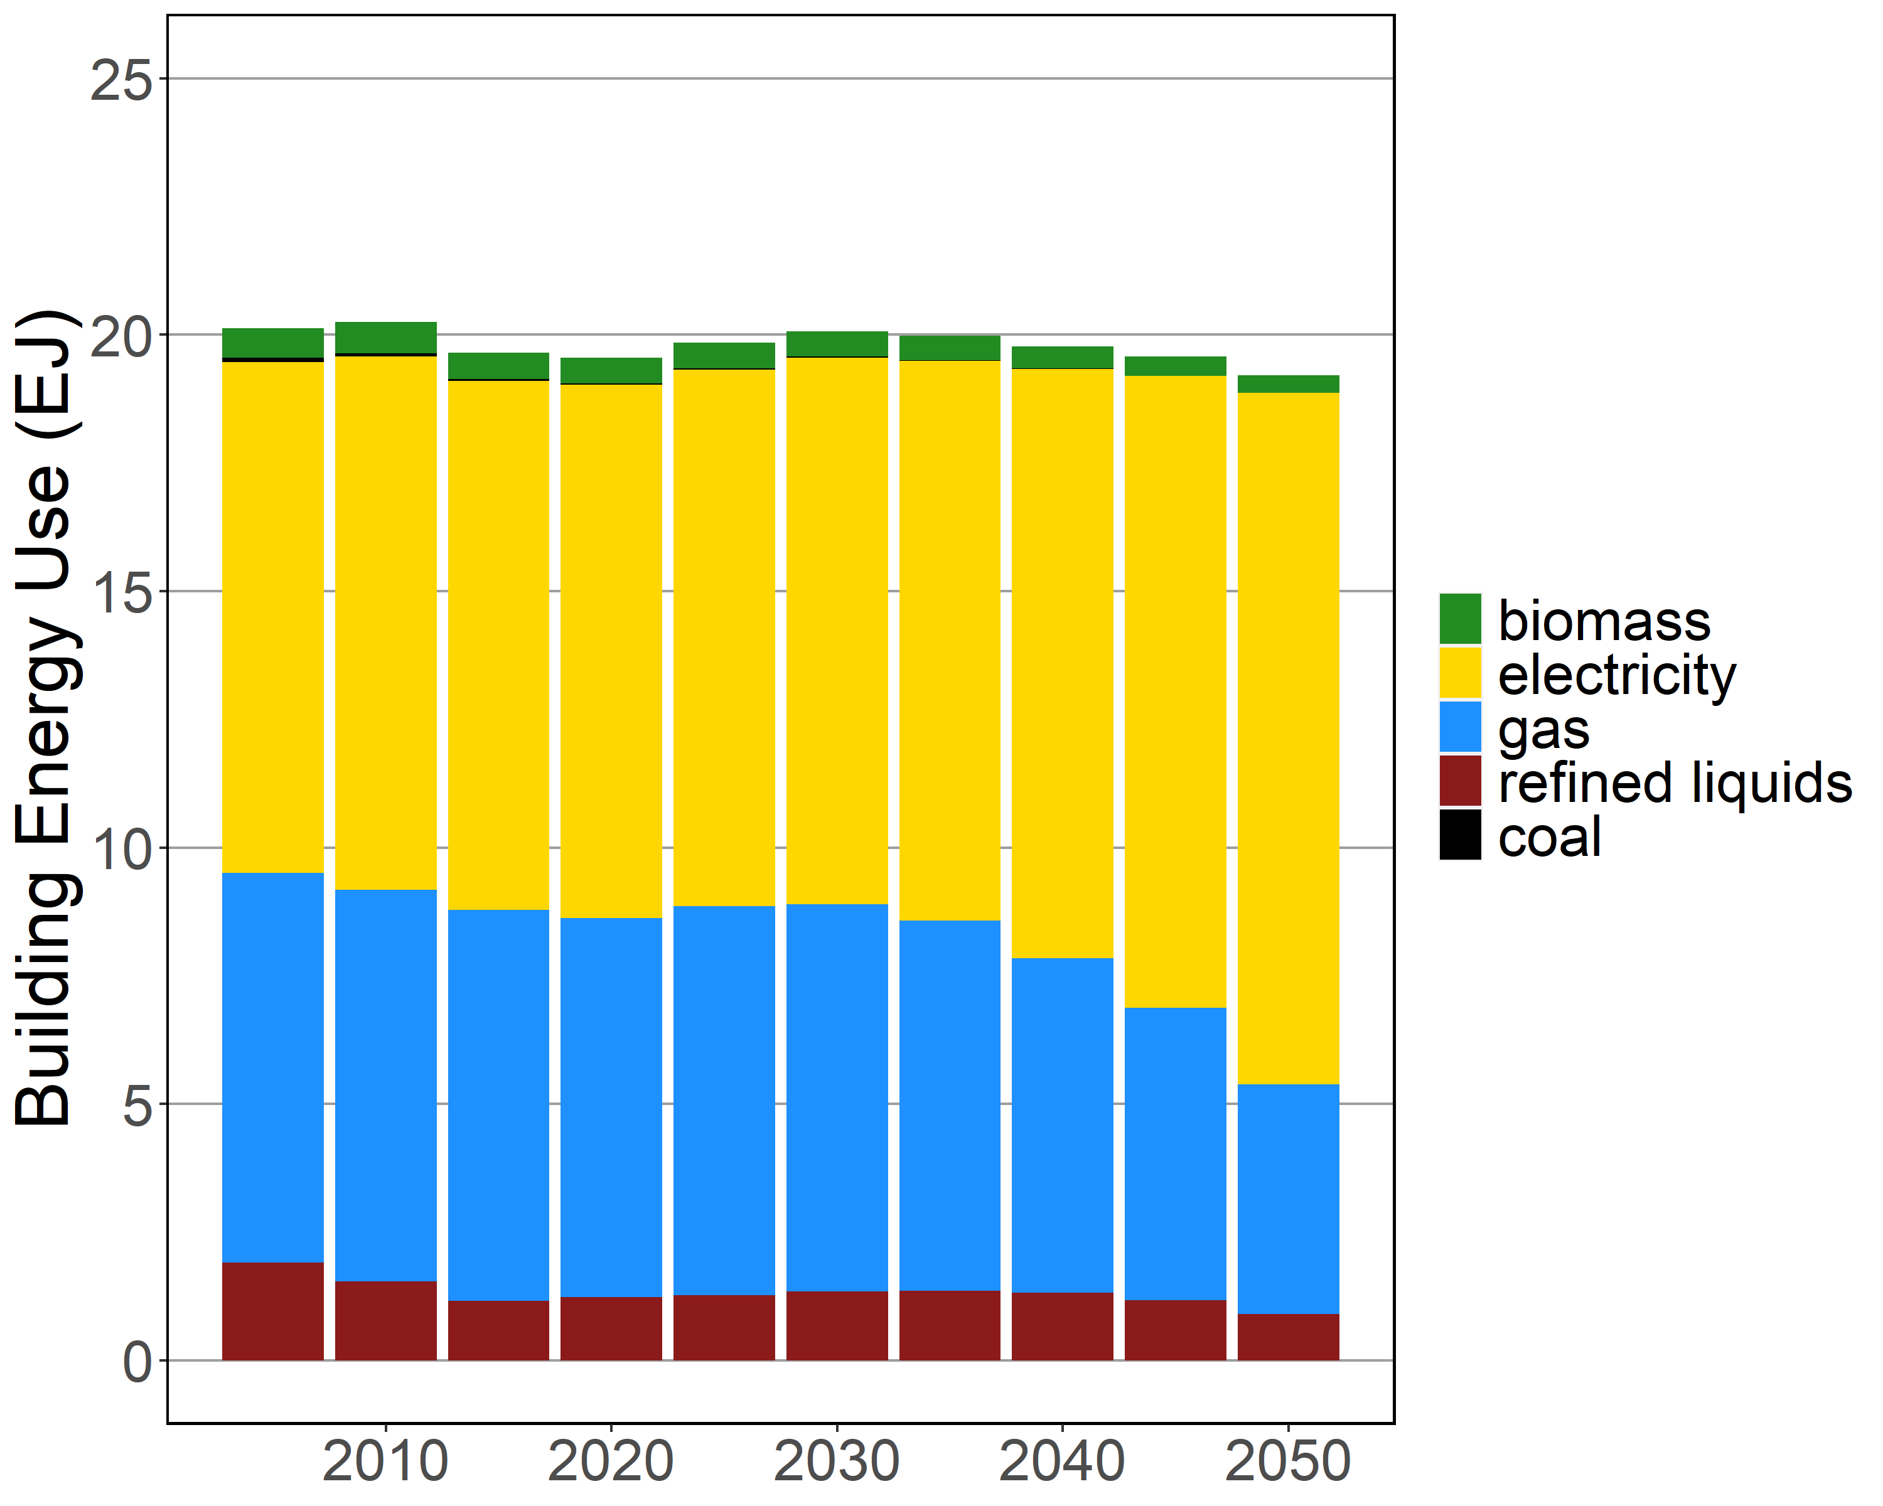
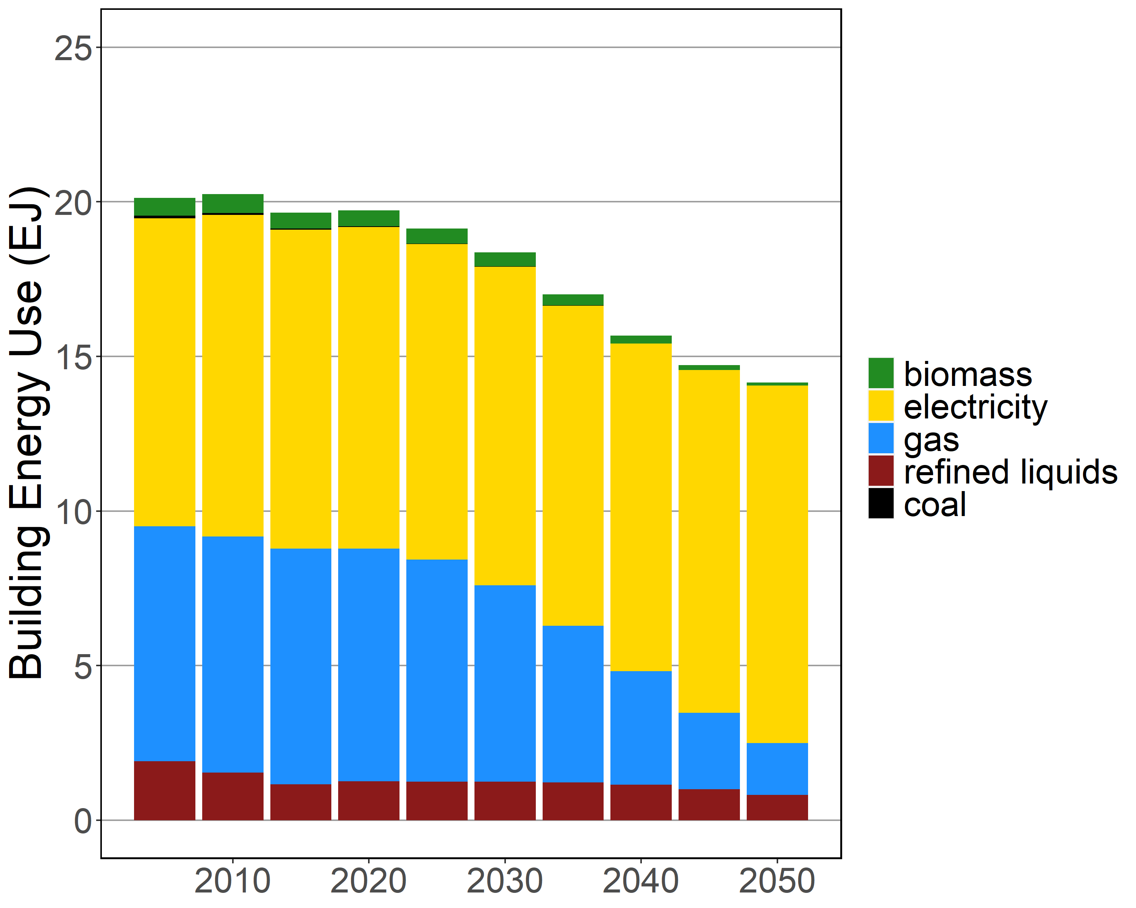
Building Final Energy
Reference Buildings Advanced Buildings

Slide 11
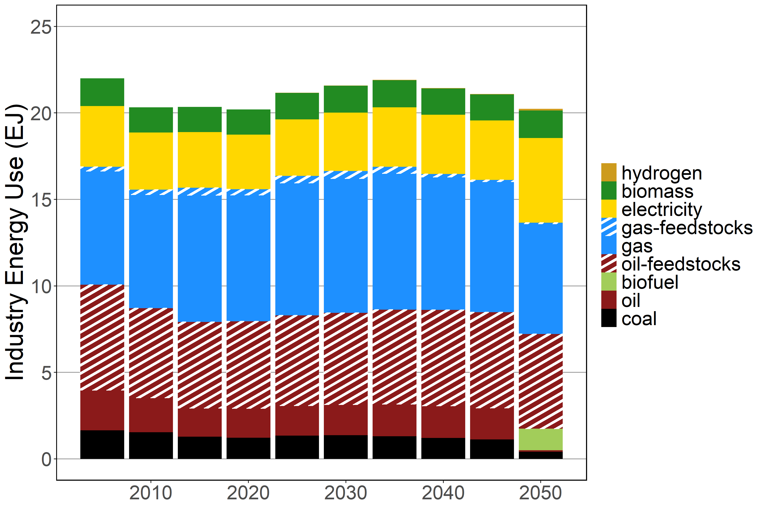
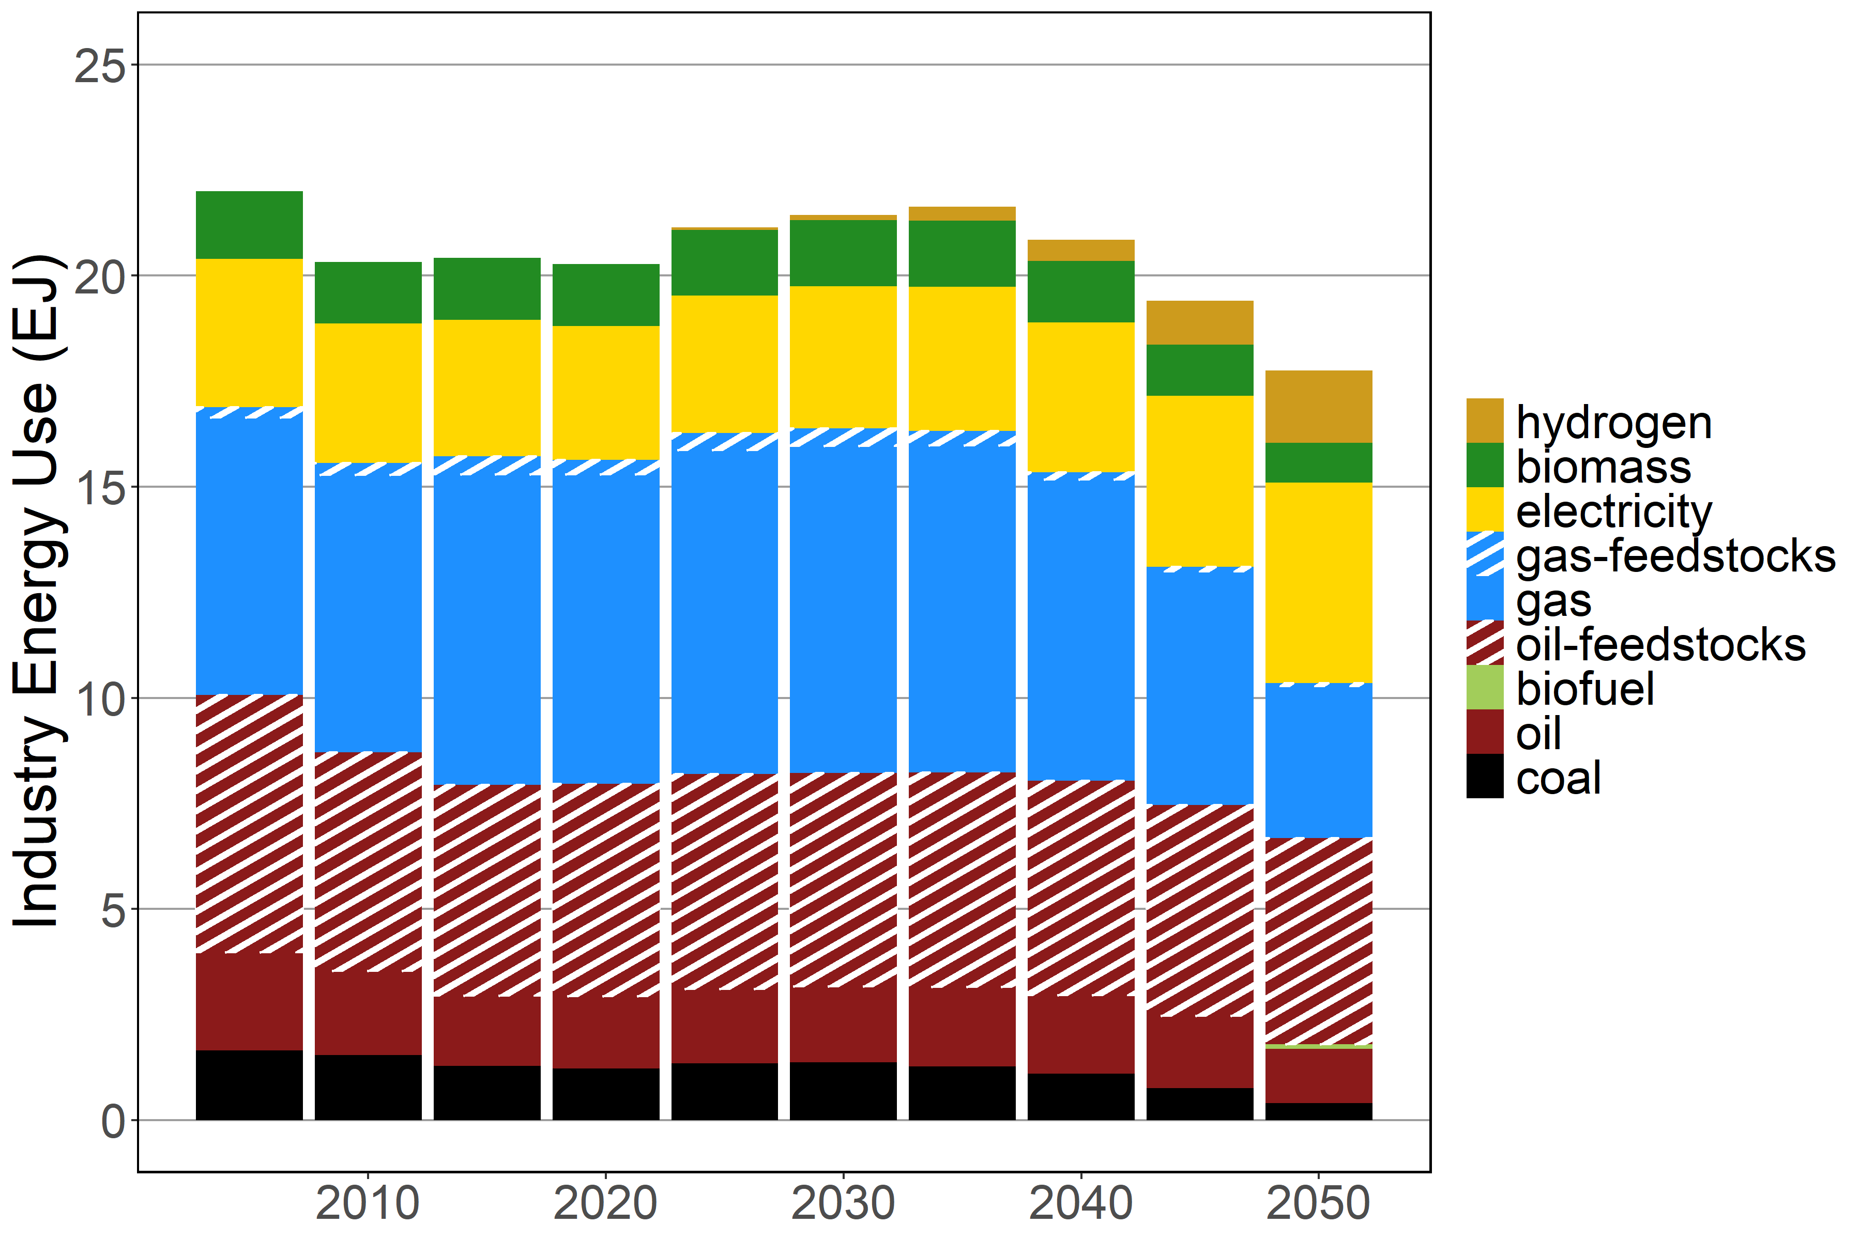
Industry Final Energy
Standard Industry Advanced Industry

Slide 12
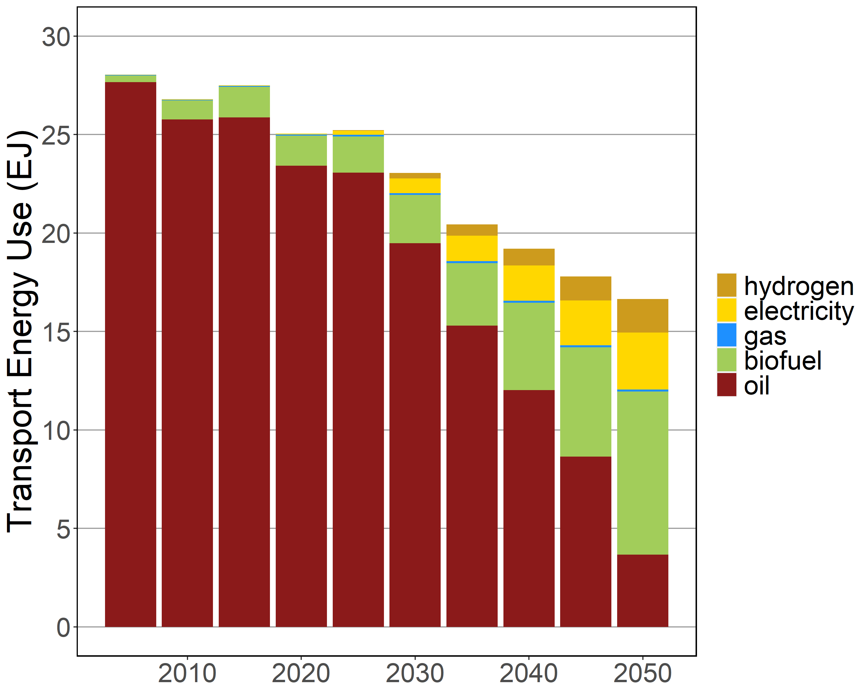
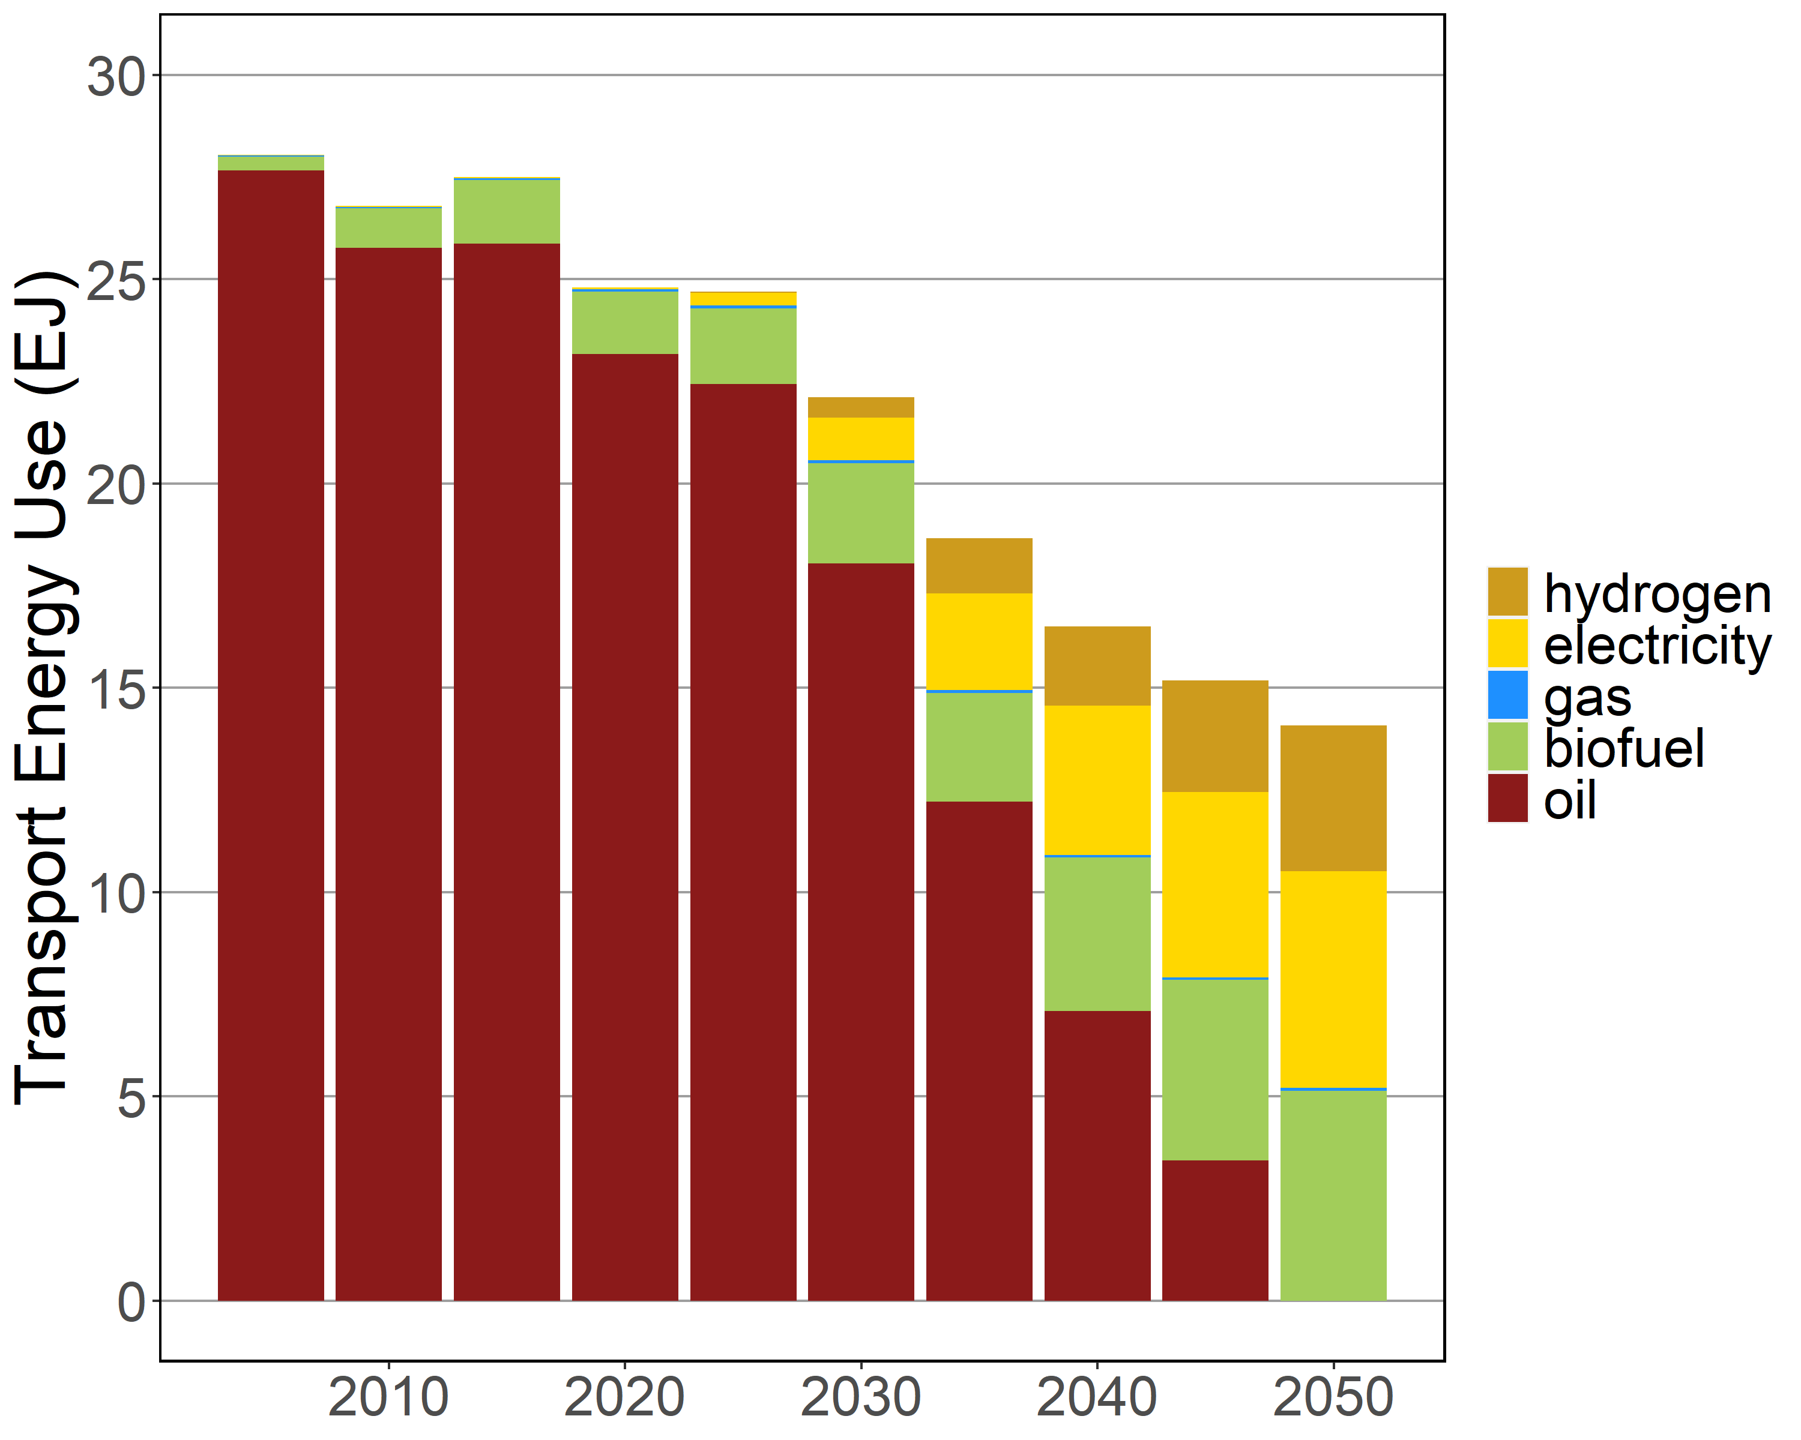
Transport Final Energy
Standard Transport Advanced Transport

Slide 13
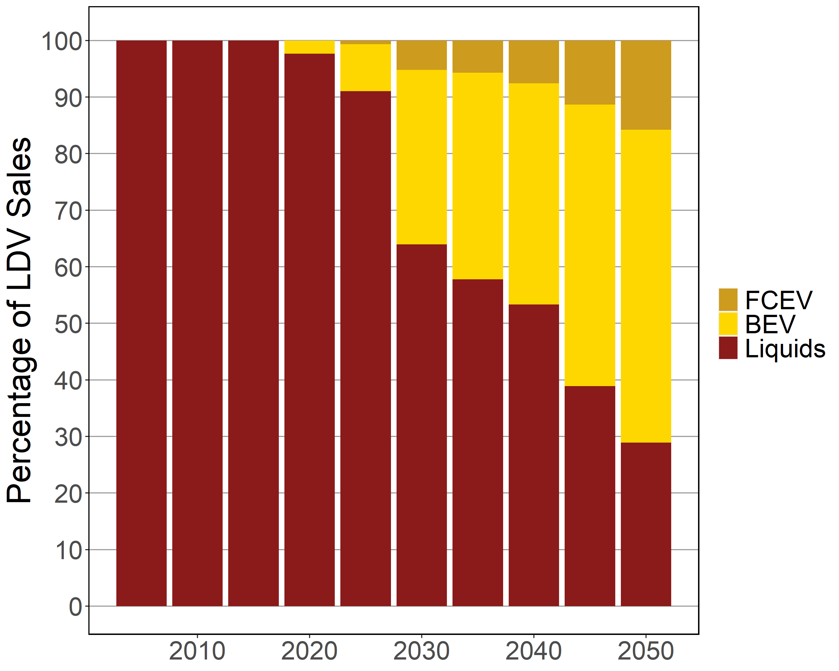
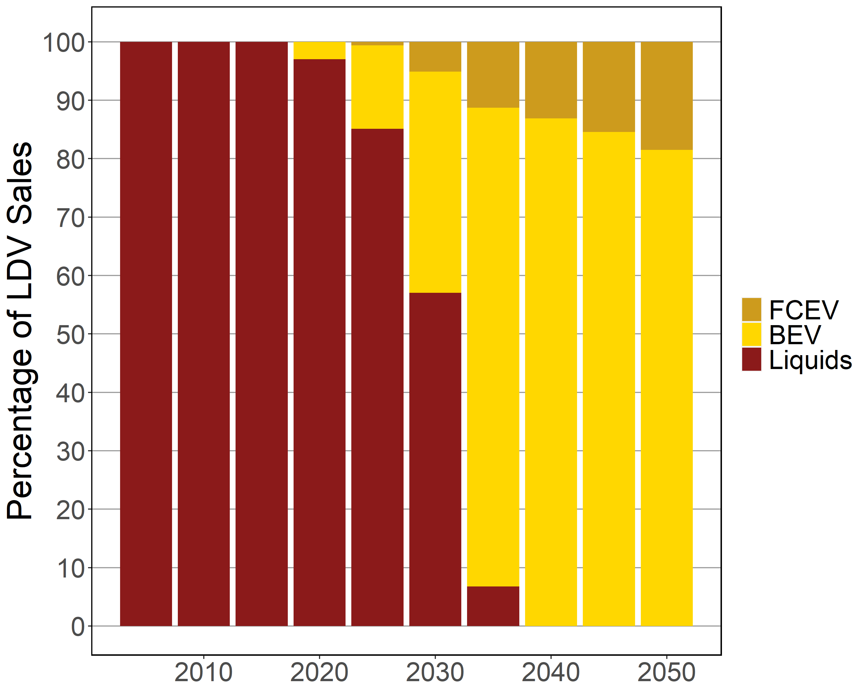
Passenger LDV Sales
Standard Transport Advanced Transport

Slide 14
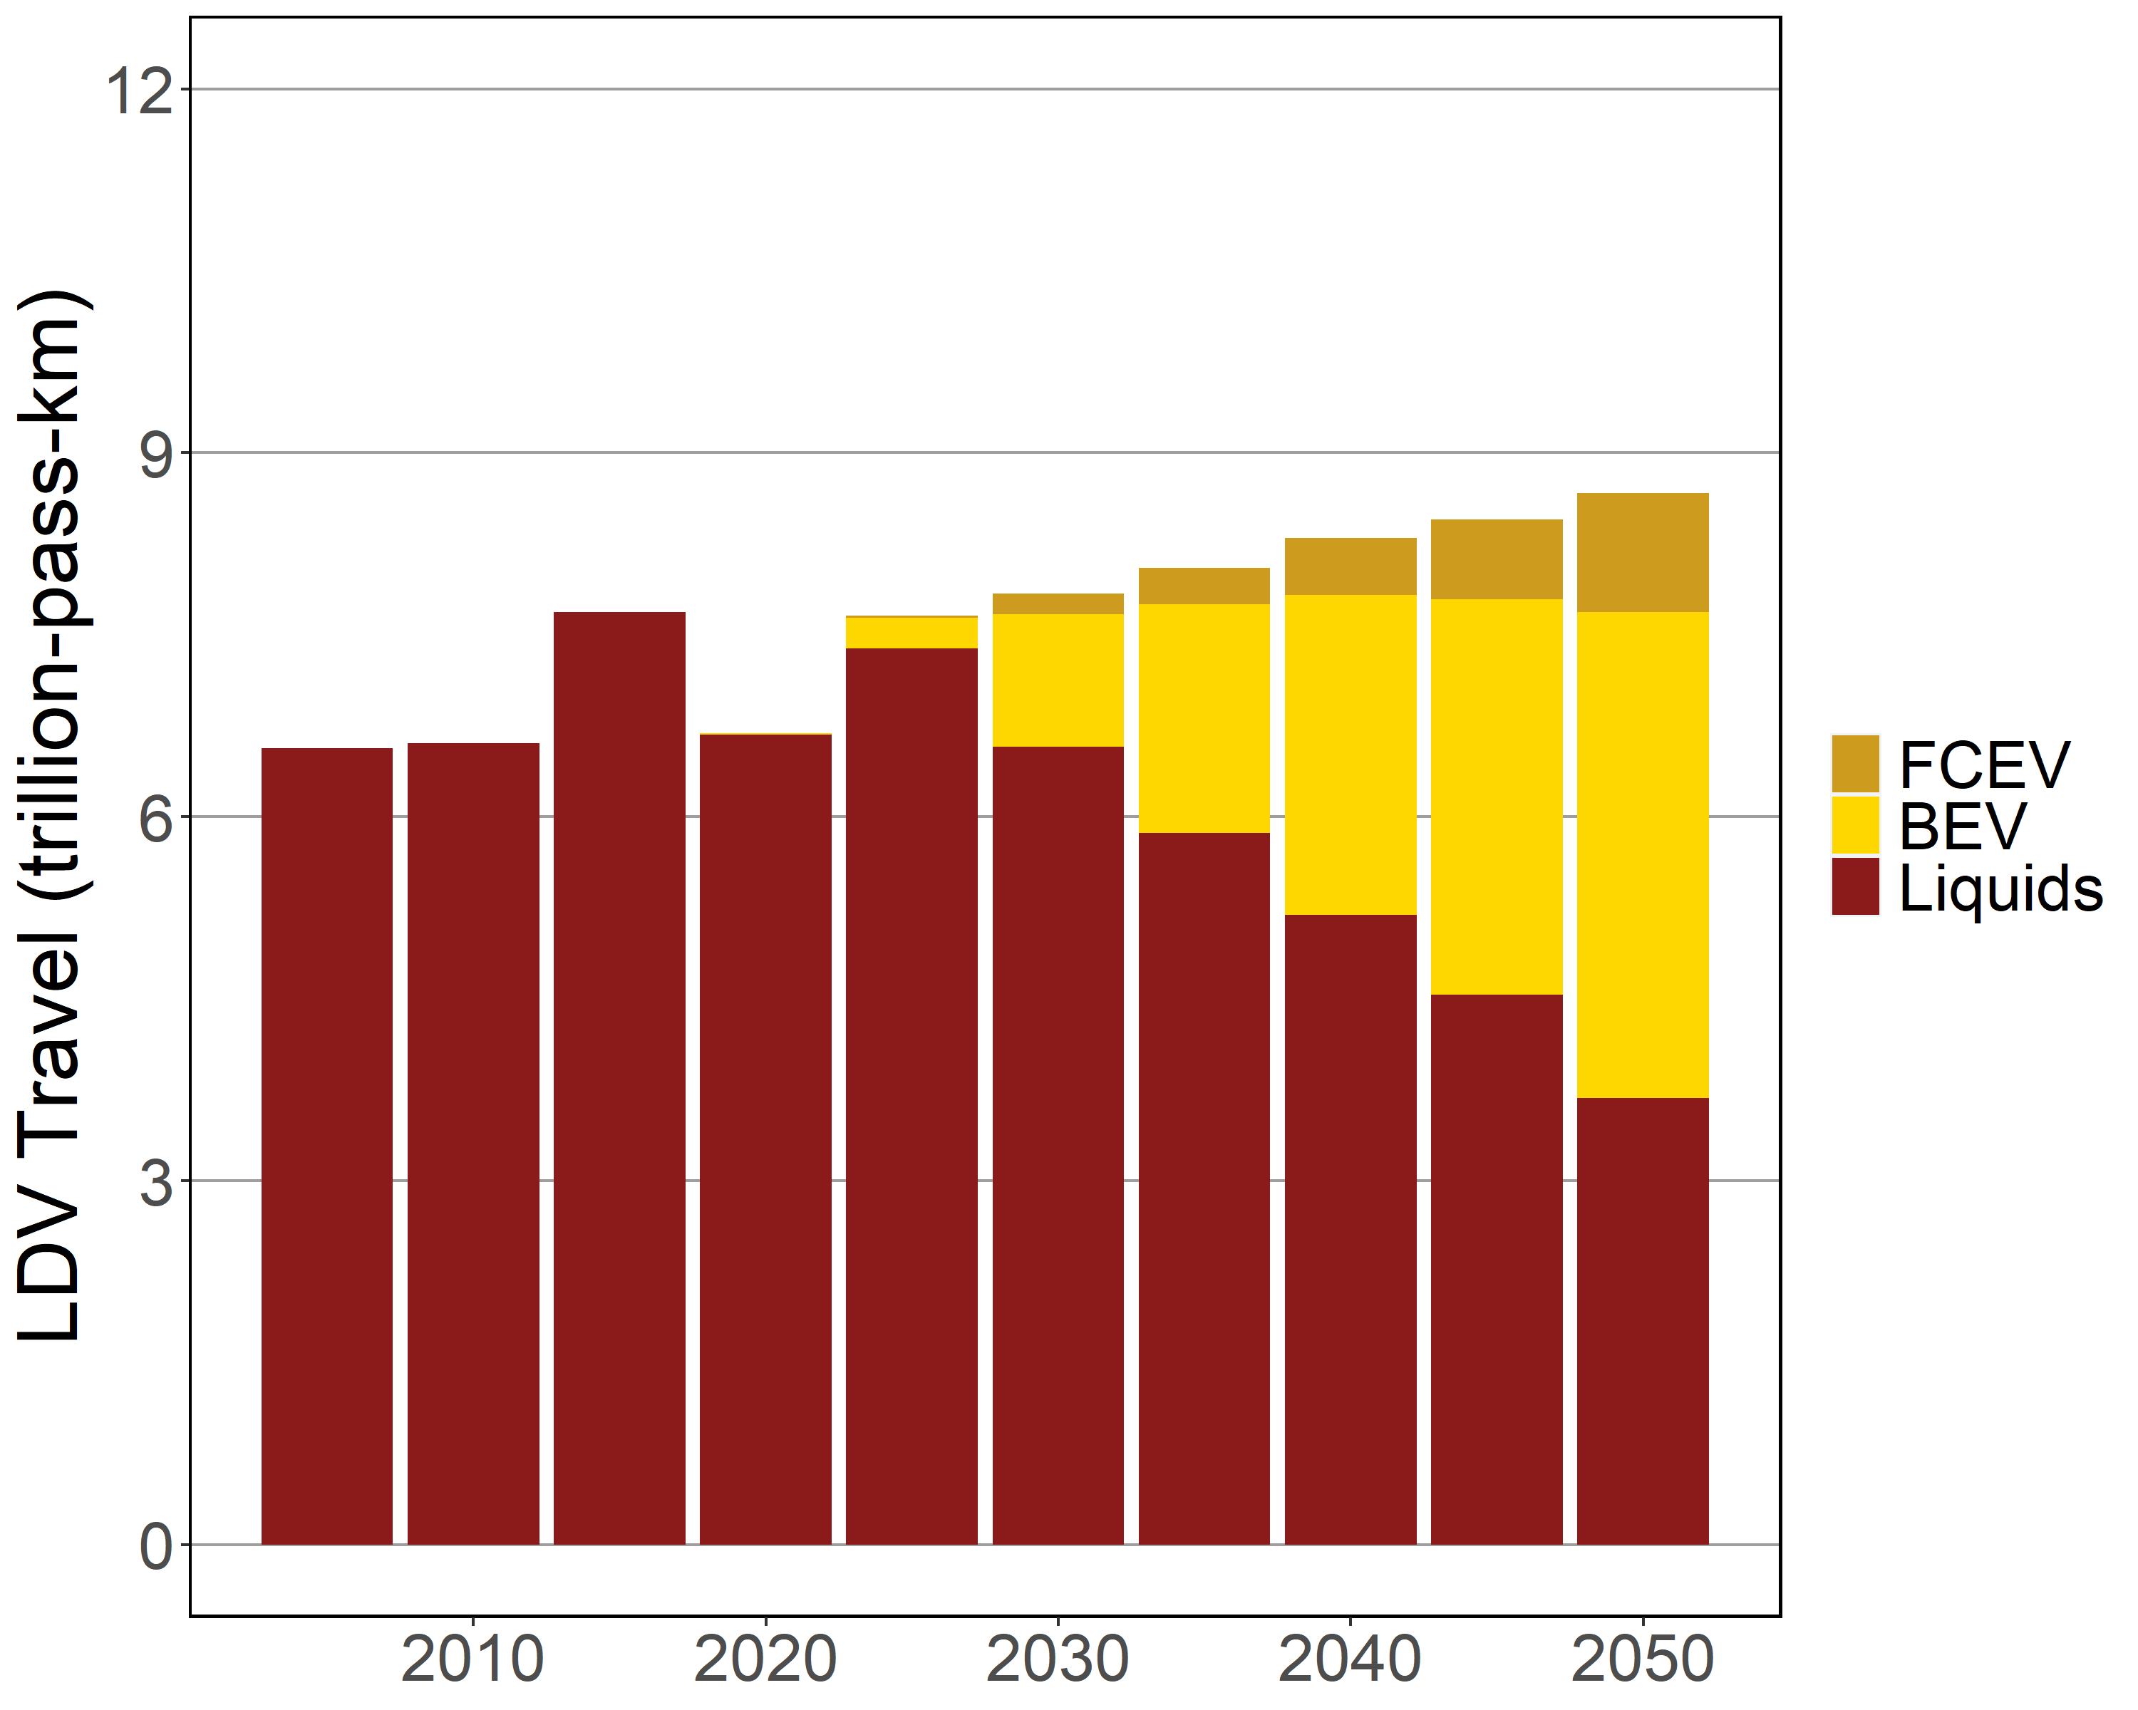
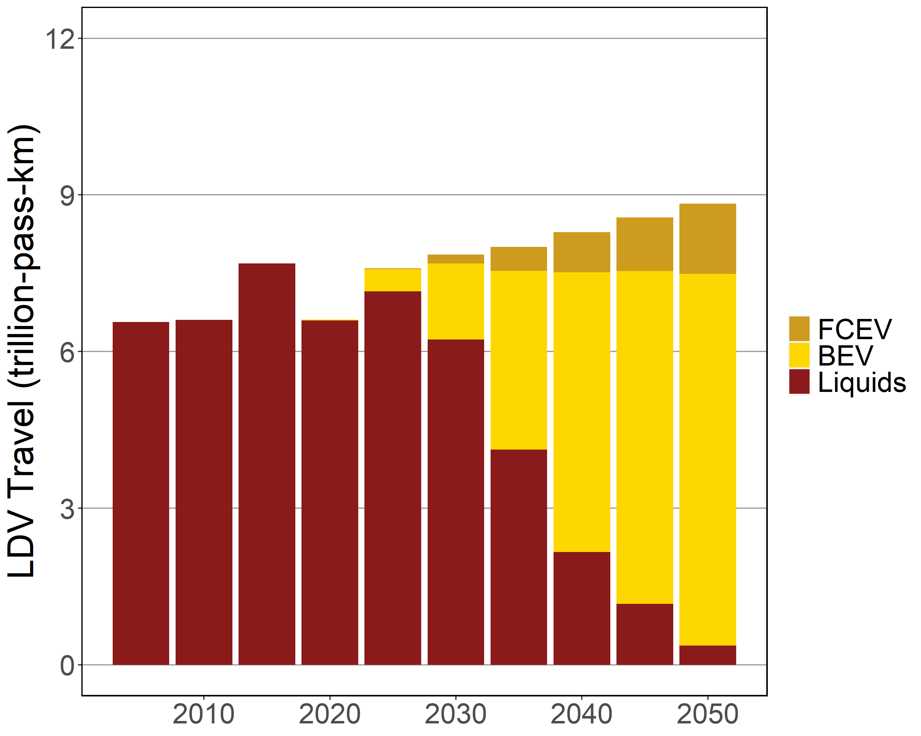
Passenger LDV Service Output
Standard Transport Advanced Transport

Slide 15
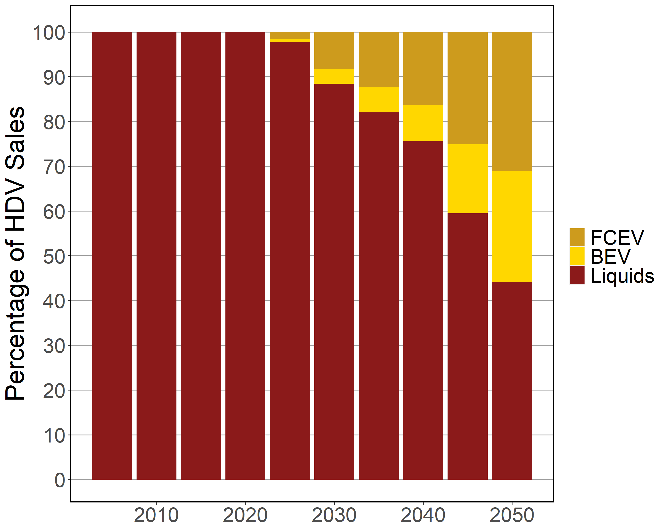
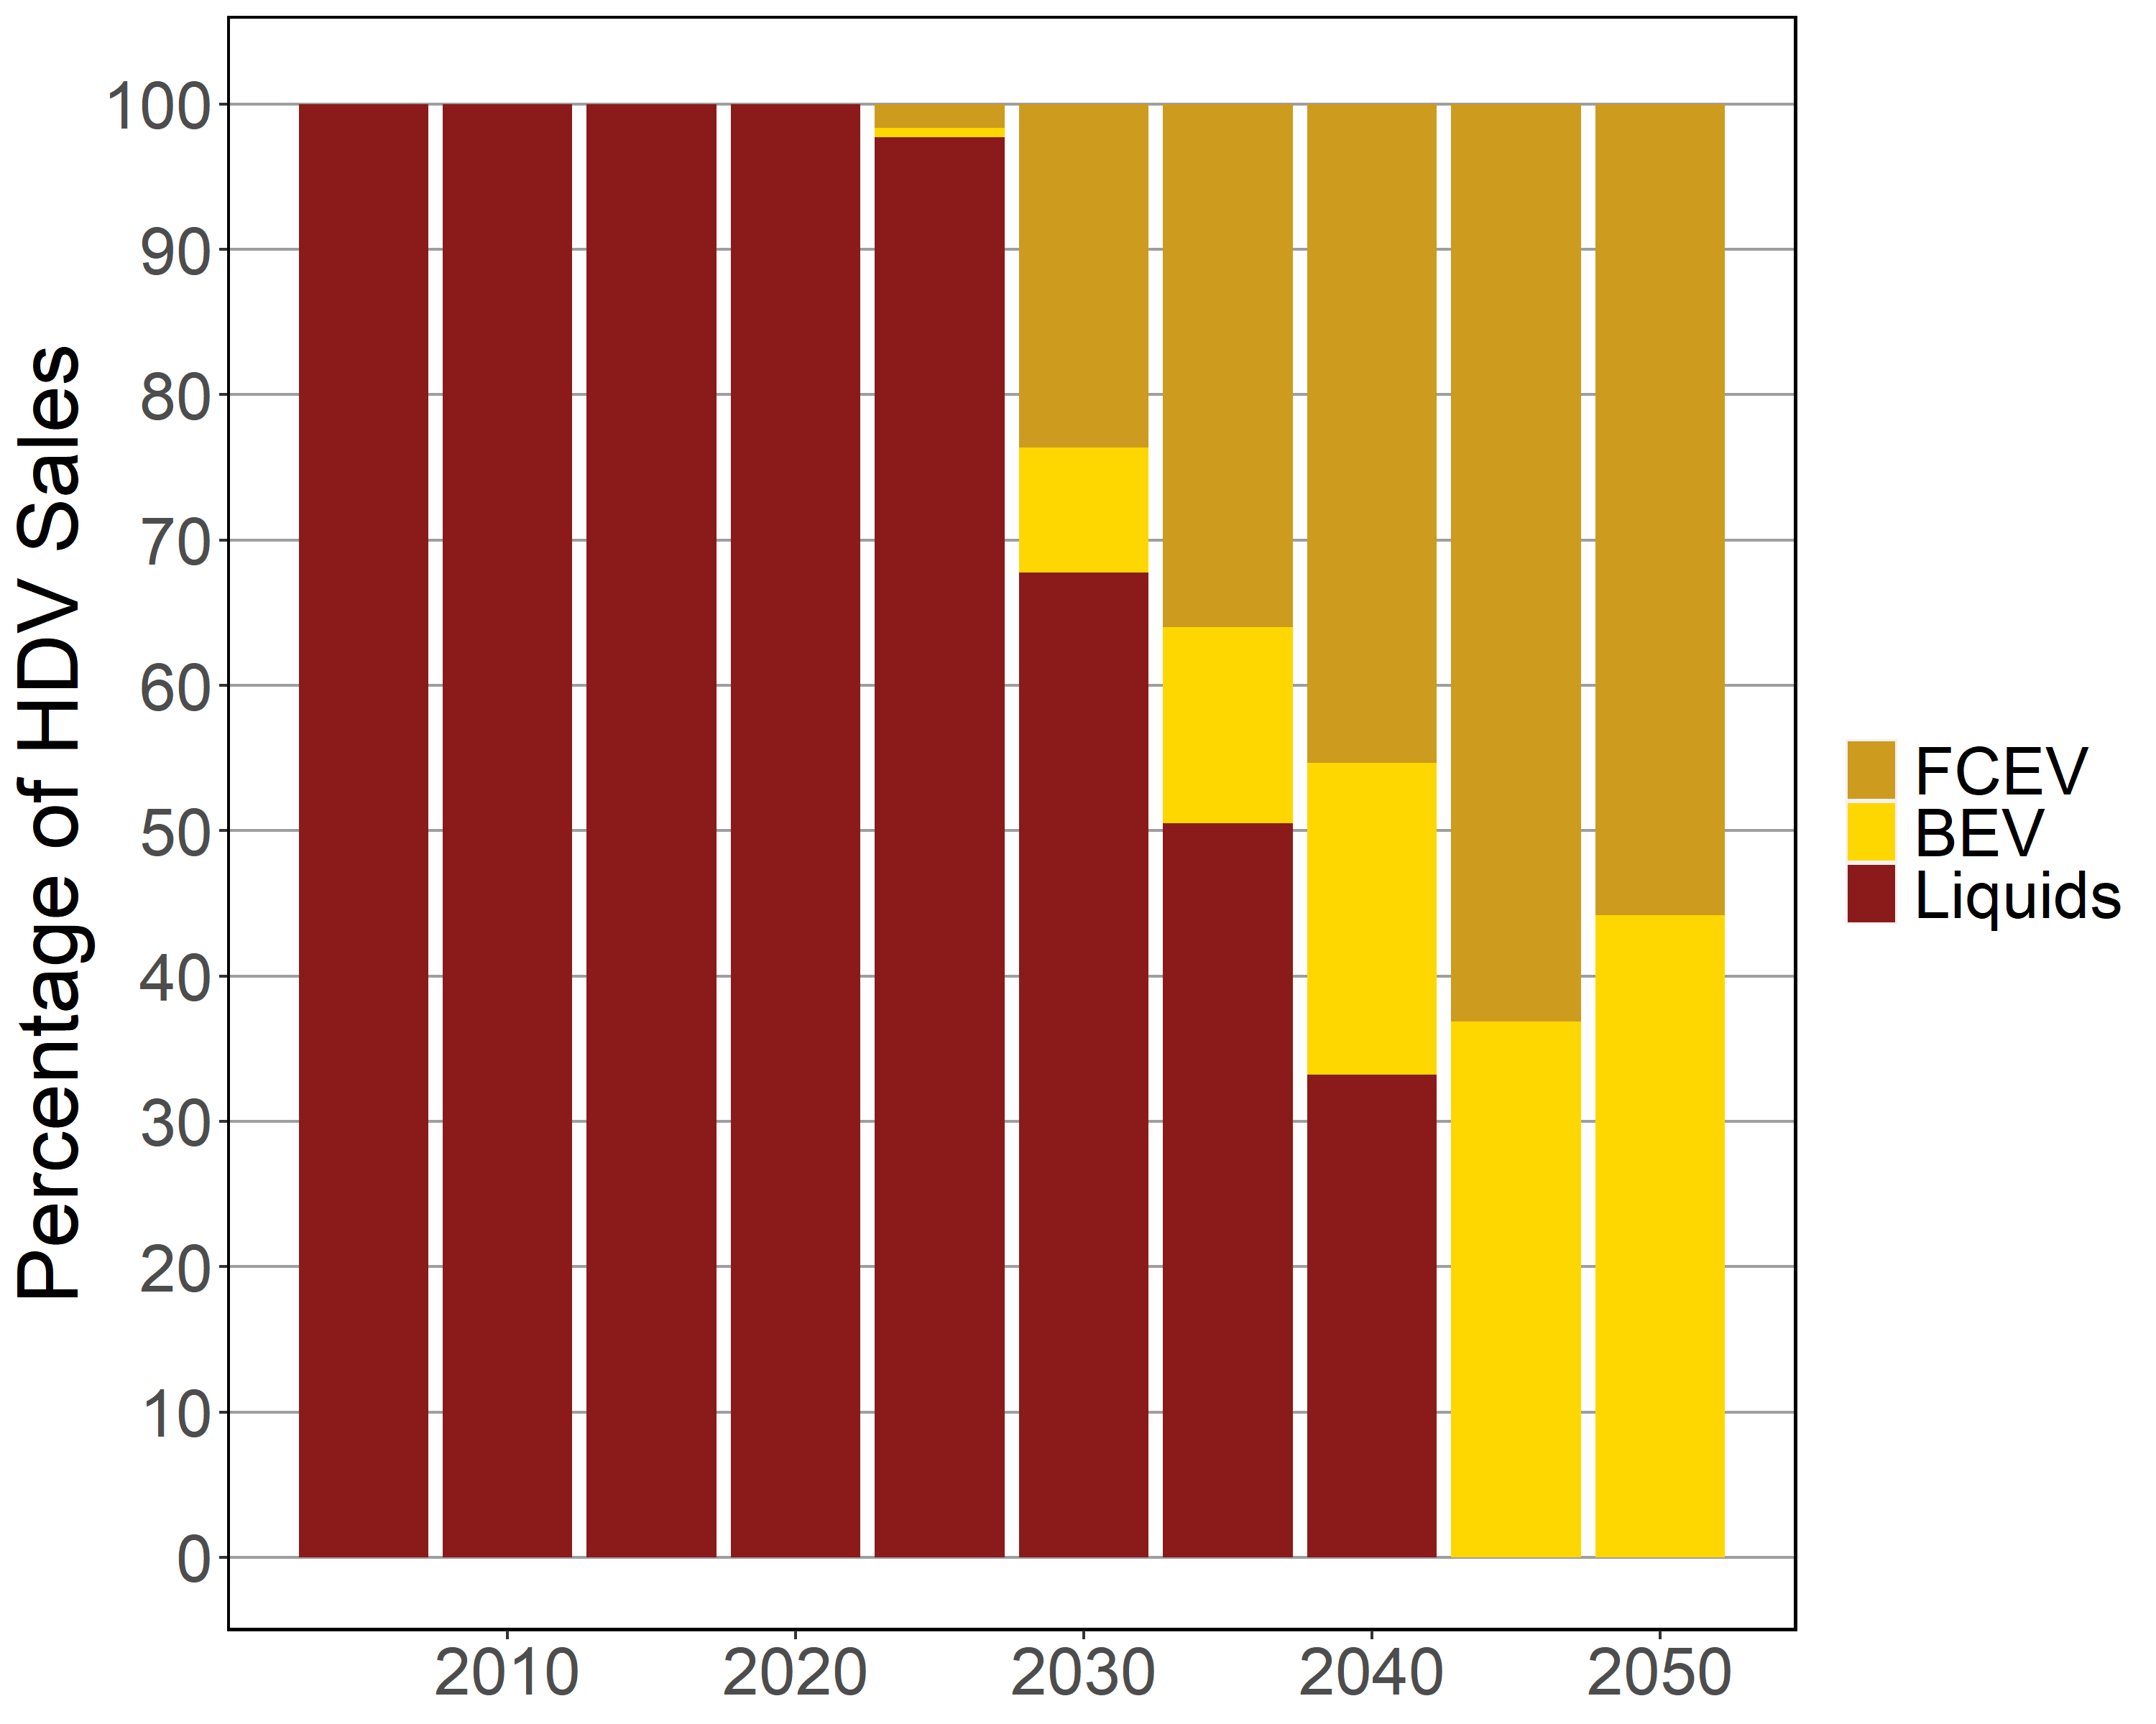
Freight Truck Sales
Standard Transport Advanced Transport

Slide 16
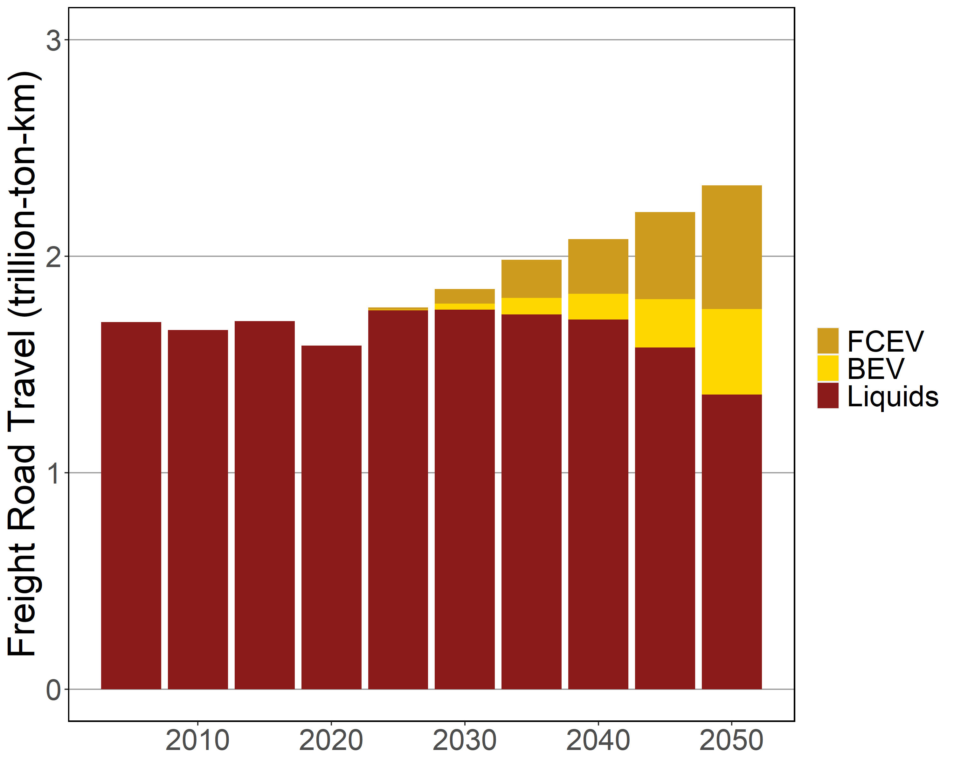
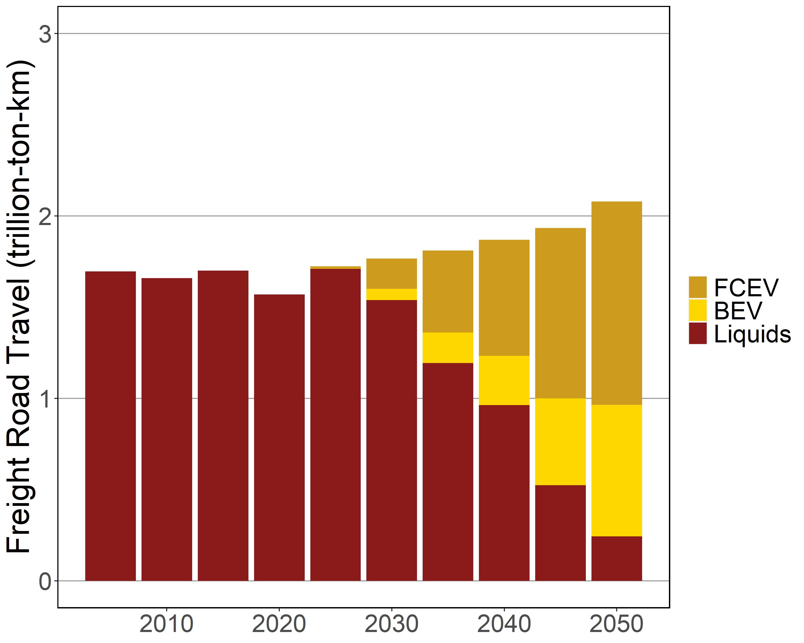
Freight Road Service Output
Standard Transport Advanced Transport

Slide 17
The U.S. Long-Term Strategy

Slide 18
Lessons Learned from the U.S. LTS
Net-Zero emission modeling is really hard
Net-Zero GHG modeling is really REALLY hard
Negative part is just as important as the positive part
We can’t just wave a magic wand (carbon tax) and call it done
We need to listen to the detailed sector models and experts
Getting to net-zero emission is really hard

Slide 19

The 2015 Paris Agreement set up a process to revise countries’ emission reduction pledges every five years
The United Nations’ 26th Conference of Parties (COP) held in Glasgow in November 2021 was a waypoint in the updating process

Slide 20
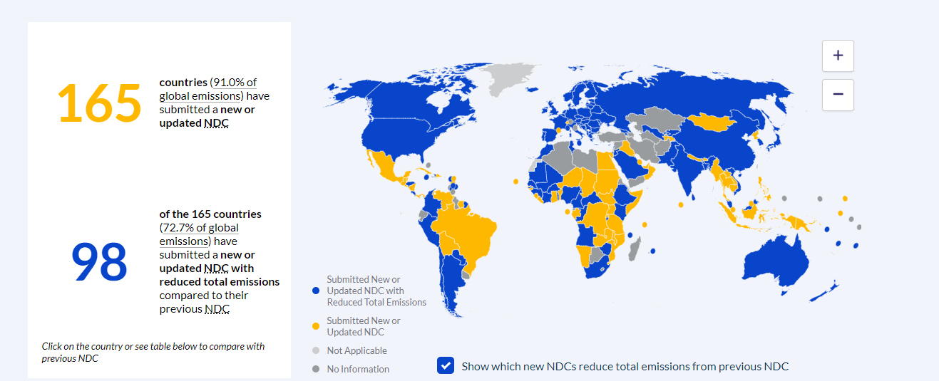
Over 150 countries submitted updated or new Nationally Determined Contributions (NDCs) outlining actions through 2030
Source: https://www.climatewatchdata.org/

Slide 21
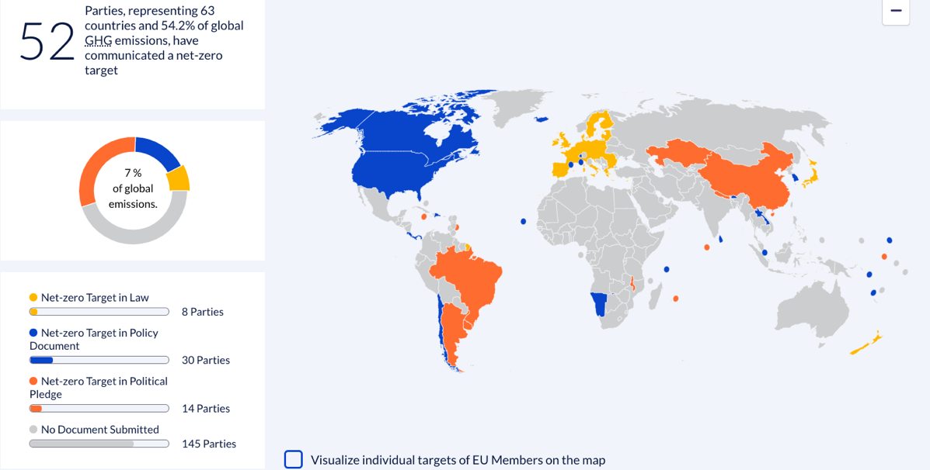


Countries also submitted long-term strategies and net-zero pledges outlining actions through mid-century
Source: https://www.climatewatchdata.org/

Slide 22
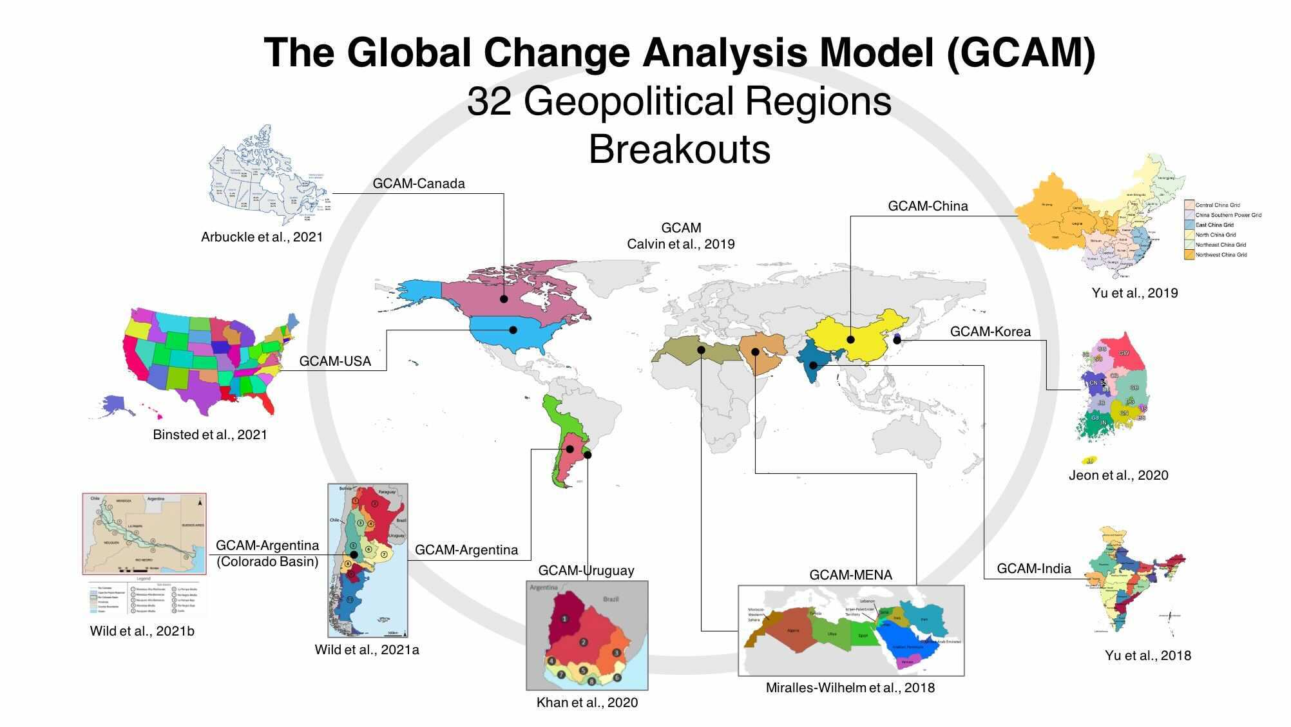
U.S. Long-Term Strategy for Net-Zero Pathways
Notes:
Miralles-Wilhelm, F., Hejazi, M., Kim, S., Yonkofski, C., Watson, D., Kyle, P., ... & Clarke, L. (2018). Water for Food and Energy Security: An Assessment of the Impacts of Water Scarcity on Agricultural Production and Electricity Generation in the Middle East and North Africa. World Bank.
Jeon, S., Roh, M., Oh, J., & Kim, S. (2020). Development of an Integrated Assessment Model at Provincial Level: GCAM-Korea. Energies, 13(10), 2565.
Binsted, M., Iyer, G., Patel, P., Graham, N., Ou, Y., Khan, Z., ... & Wise, M. (2021). GCAM-USA v5. 3_water_dispatch: Integrated modeling of subnational US energy, water, and land systems within a global framework. Geoscientific Model Development Discussions, 1-39.
Yu, S., Horing, J., Liu, Q., Dahowski, R., Davidson, C., Edmonds, J., ... & Clarke, L. (2019). CCUS in China’s mitigation strategy: insights from integrated assessment modeling. International Journal of Greenhouse Gas Control, 84, 204-218.
Khan, Z., Wild, T. B., Carrazzone, M. E. S., Gaudioso, R., Mascari, M. P., Bianchi, F., ... & Castillo, R. M. (2020). Integrated energy-water-land nexus planning to guide national policy: an example from Uruguay. Environmental Research Letters, 15(9), 094014.
Wild, T. B., Khan, Z., Zhao, M., Suriano, M., Bereslawski, J. L., Roberts, P., ... & Ojeda‐Matos, G. (2021a). The Implications of Global Change for the Co‐Evolution of Argentina's Integrated Energy‐Water‐Land Systems. Earth's Future, 9(8), e2020EF001970.
Wild, T. B., Khan, Z., Clarke, L., Hejazi, M., Bereslawski, J. L., Suriano, M., ... & Birnbaum, A. (2021b). Integrated energy-water-land nexus planning in the Colorado River Basin (Argentina). Regional Environmental Change, 21(3), 1-16.
Yu, S., Evans, M., Kyle, P., Vu, L., Tan, Q., Gupta, A., & Patel, P. (2018). Implementing nationally determined contributions: building energy policies in India’s mitigation strategy. Environmental Research Letters, 13(3), 034034.
Arbuckle, E. J., Binsted, M., Davies, E. G., Chiappori, D. V., Bergero, C., Siddiqui, M. S., ... & Macaluso, N. (2021). Insights for Canadian electricity generation planning from an integrated assessment model: Should we be more cautious about hydropower cost overruns?. Energy Policy, 150, 112138.
Calvin, K., Patel, P., Clarke, L., Asrar, G., Bond-Lamberty, B., Cui, R. Y., ... & Wise, M. (2019). GCAM v5. 1: representing the linkages between energy, water, land, climate, and economic systems. Geoscientific Model Development, 12(2), 677-698.

Slide 23
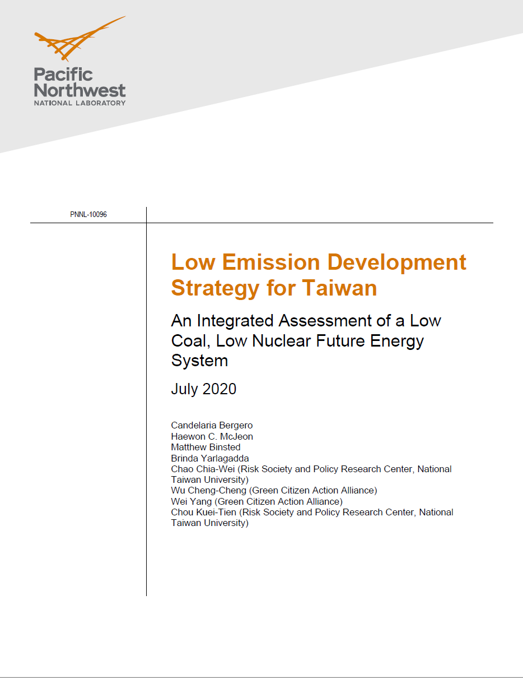

Slide 24
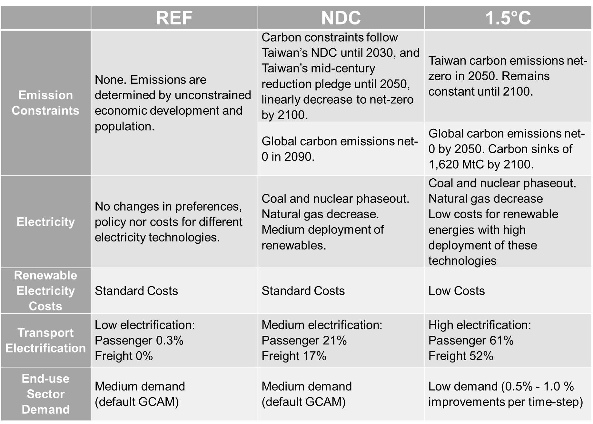
Scenarios

Slide 25
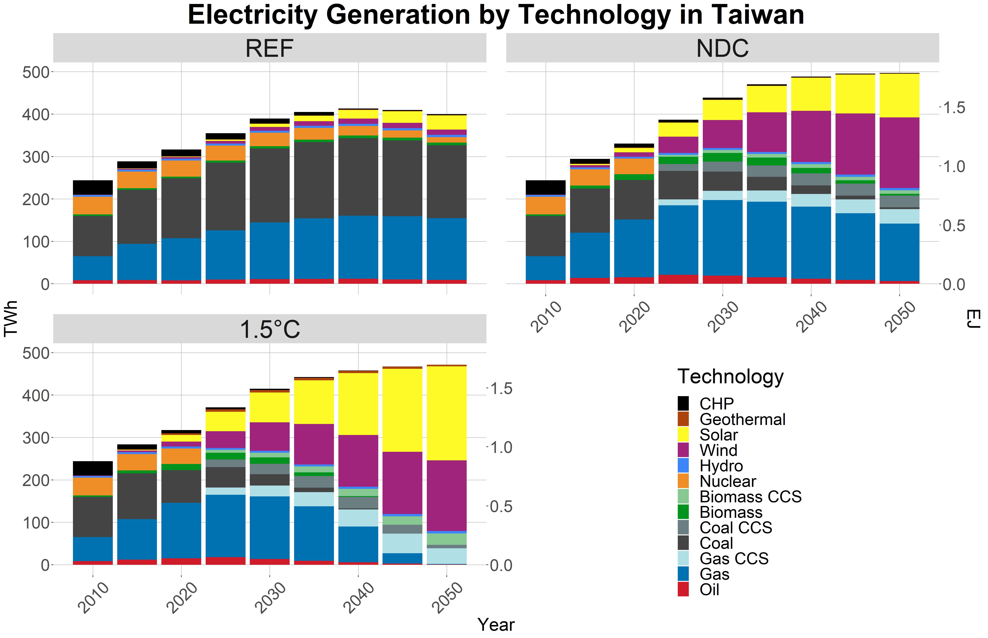
Electricity Generation

Slide 26
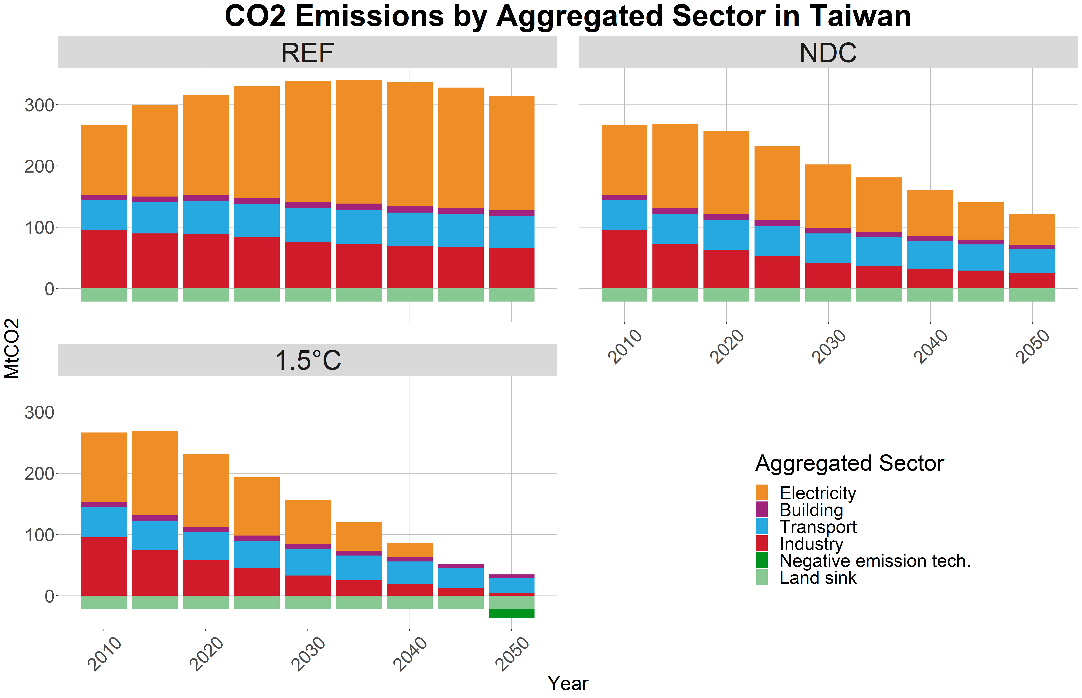
CO2 Emissions

Slide 27
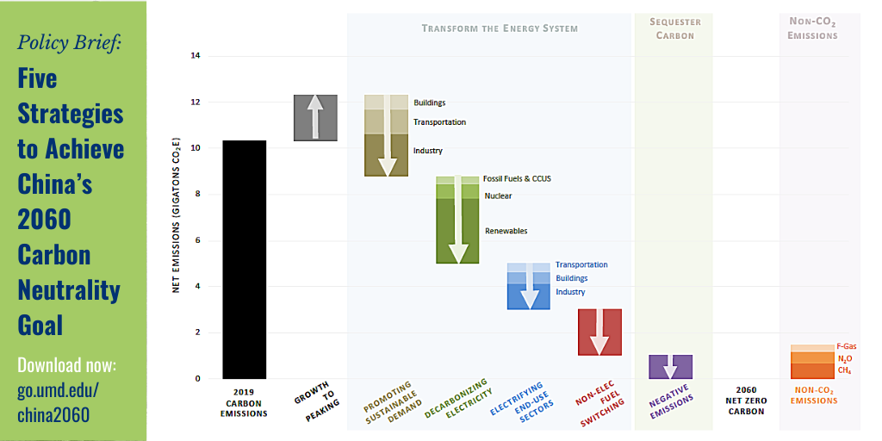

Slide 28
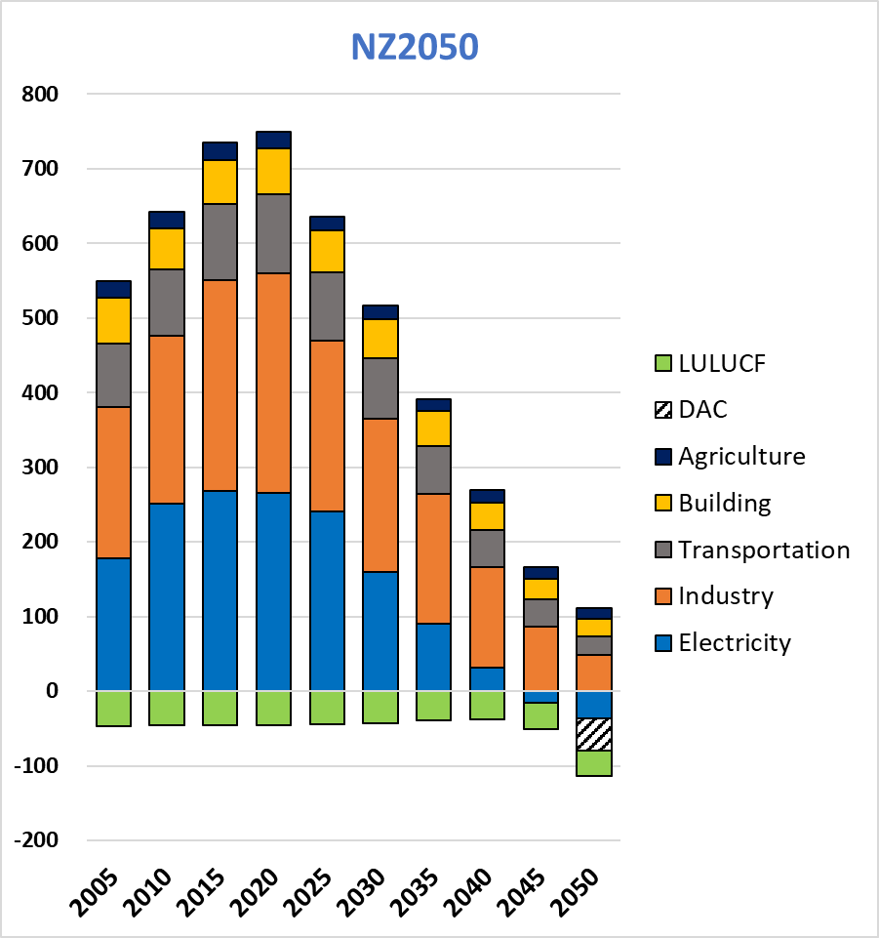
Result
GHG Emission by Sector
The dramatic GHG reduction demonstrates the need for rapid changes in entire energy system.
Negative emission technologies are critical to offset hard-to-abate emissions .
Mt CO₂e
Year
Hanwoong KIM Center for Sustainable Development 15th IAMC, November 30, 2022
Notes:
Along with the GHG emission pathways, the GHG emissions were classified by sector to find out the reduction burden of each sector.
Compared to Curpol on the left, the other three scenarios show a rapid reduction in GHG emissions, which requires significant changes in the energy system.
In addition, negative emissions technology seems essential to address the remaining GHG in 2050 in common across scenarios.
Our study shows that the power and industrial sectors are the most significant contributors to carbon neutrality, followed by transportation and buildings.

Slide 29
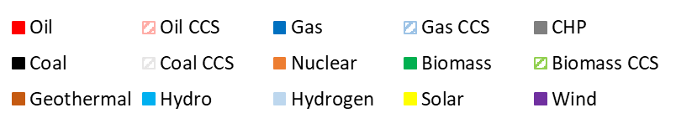
Result
Electricity generation
Carbon-neutrality require drastic change: Substituting fossil fuels to low carbon sources
TWh
Year
Hanwoong KIM Center for Sustainable Development 15th IAMC, November 30, 2022
Notes:
Compare to current policy scenario, a much faster transition occurs when climate policies are in place.
The three carbon-neutral scenarios in common suggest coal phase-out under the three carbon neutrality pathways.
However, each NZ scenario provides different technology options.
A. The NZ2050 scenario is made up of CCS technology and renewable energy.
B. In the NZ2050_Nuc scenario, centered on nuclear power.
Due to limited CCS technology, C. NZ2050_NoCCS scenario relies more on renewable energy than NZ2050.

Slide 30
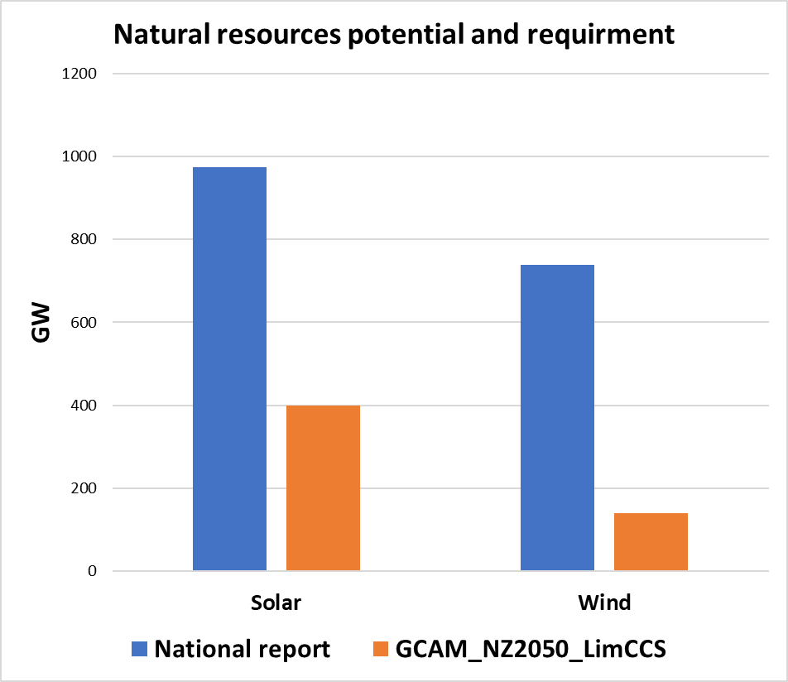
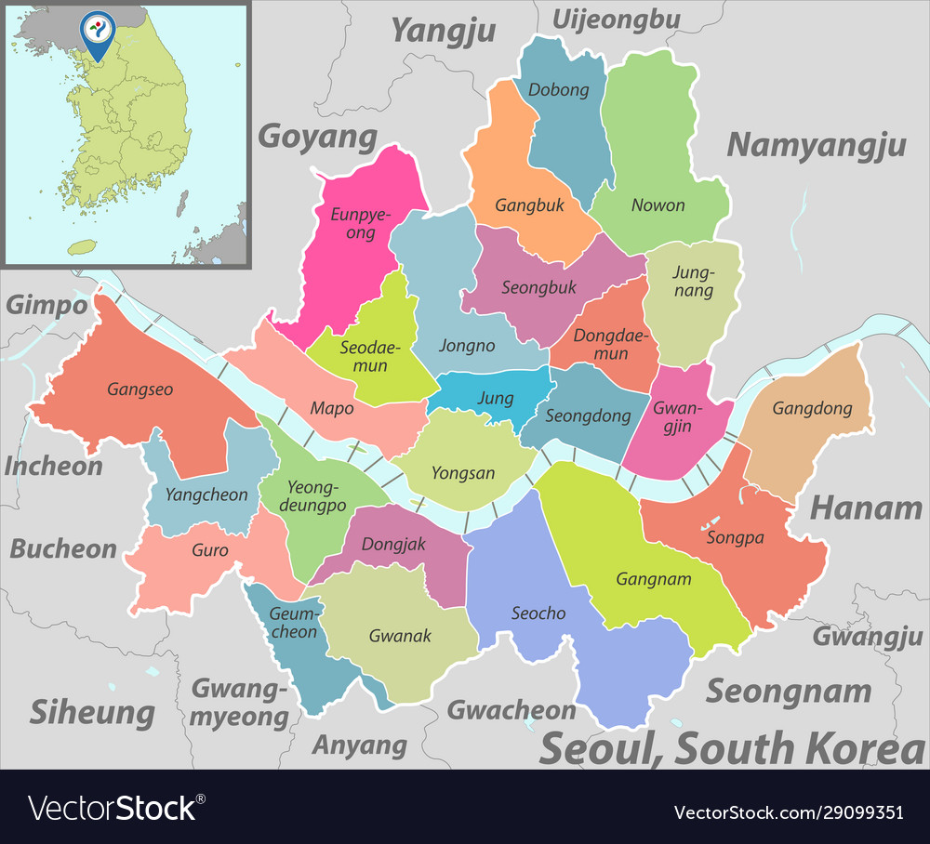
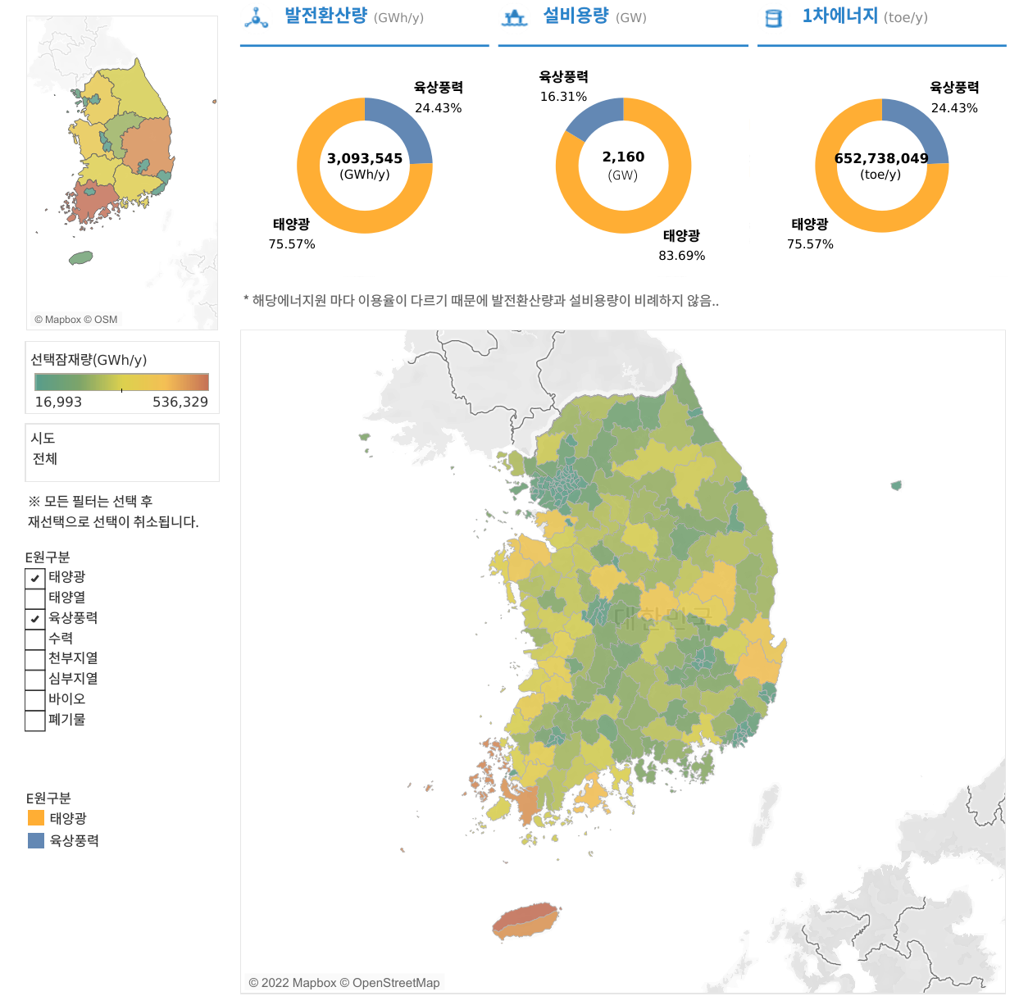
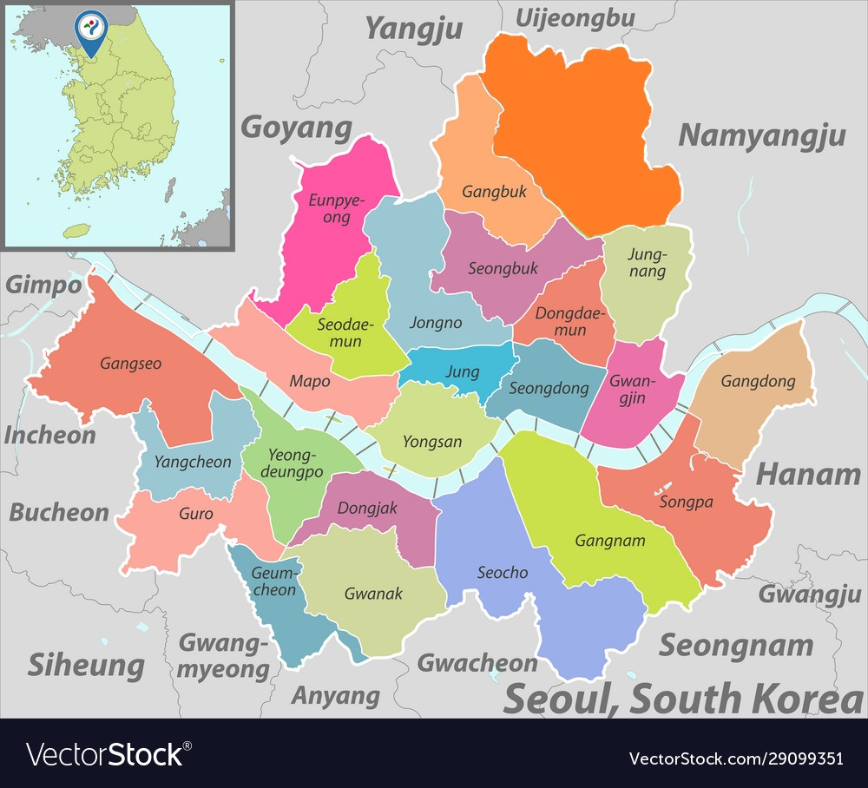
Result
Potential resources & land requirement
Solar power plants_NZ2050_NoCCS
Electricity Generation (GWh/y)
Capacity (GW)
Primary Energy (toe/y)
On_Wind
24.43%
On_Wind
16.31%
On_Wind
24.43%
605.2KM²
X 6
Solar
75.57%
Solar
83.69%
Solar
75.57%
Natural Resources Potential (GWh/y)
GCAM_NZ2050_NoCCS
Nuclear power plants_NZ2050_Nuc
On_Wind
10% of the size of Seoul
Solar
1GW nuclear power plant requires the land size of 0.745km2 (including the geological land and sea area)
[Source: KIER, Renewable Energy Potential Map, 2022]
[Source: Korea energy agency, Renewable Energy White Paper, 2020]
[Source: KOPIA, A plan to secure locations for each photovoltaic area to achieve carbon]
[Source: National Assembly Budget Office "Report on Area Required by Power Generation Source" 2017]
Hanwoong KIM Center for Sustainable Development 15th IAMC, November 30, 2022
Notes:
The left figure shows Korea's renewable energy technical potential.
In Korea, Solar power has about 1000 GW of technical potential.
The most extreme scenario, the NZ2050_NoCCS scenario, requires about 6 times the size of Seoul.
However, in the NZ2050_nuc scenario, 2 times the size of Seoul for solar power
and only about 10% of the area of Seoul is needed to build a nuclear power plant.
If Korea's energy policy focuses only on solar technology, the feasibility of achieving 2050 carbon neutrality may be lowered due to land use problems.

Slide 31
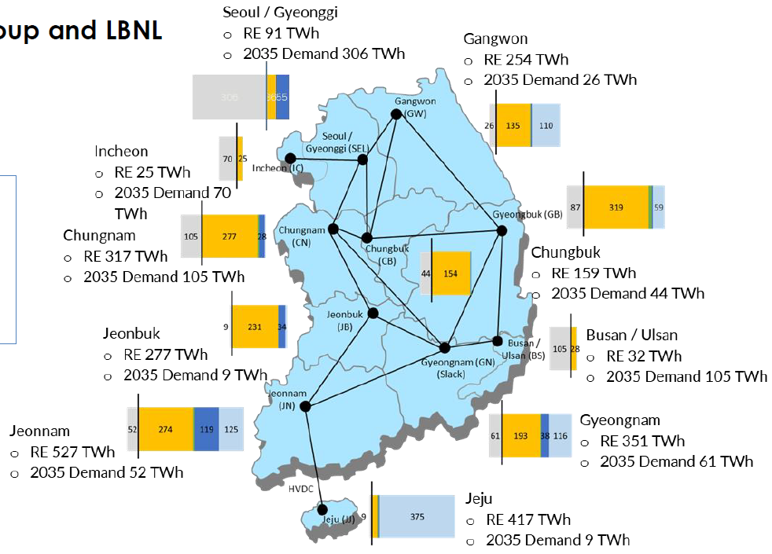
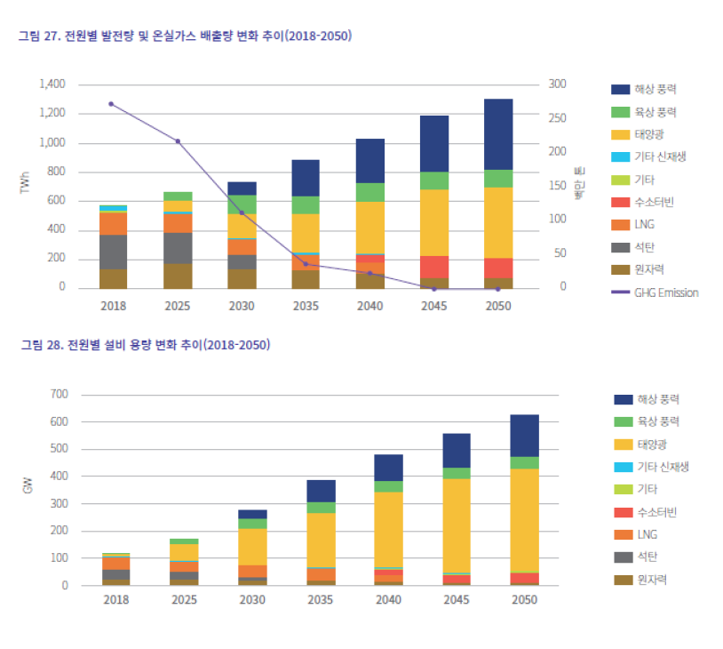
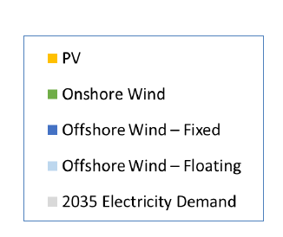
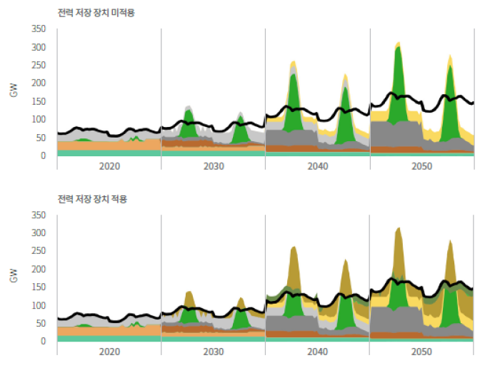


Renewable Energy Potential
GHG emissions pathways and Electricity Generation by technology
Offshore_wind
Onshore_wind
Solar_PV
Other Renewable Energy
Hydrogen
LNG
Coal
Nuclear
GHG Emission
NZ2050 Total Electricity Generation
TWh
Mt CO2eq
Summer and winter power generation (Storage option)
Electricity Capacity by technology
Without Storage
Offshore_wind
Onshore_wind
Solar_PV
Other Renewable Energy
Hydrogen
LNG
Coal
Nuclear
GW
With Storage
Solar: 370, 300 (NZ2050)
Wind: 200, 110 (NZ2050)
Hanwoong KIM Center for Sustainable Development 15th IAMC, November 30, 2022
Notes:
To concern of power system stability when we reach to 2050 Net zero, I compare with the recent Korea's report, which is considering more deeply on transmission constructing and 8760 hours resolution for electricity generation. This assessment and this study are largely consistent in terms of generation, capacity by technology.

Slide 32
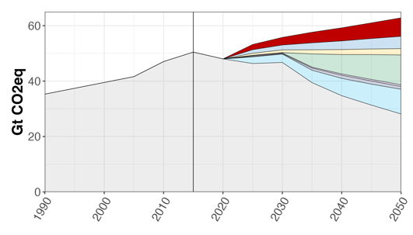
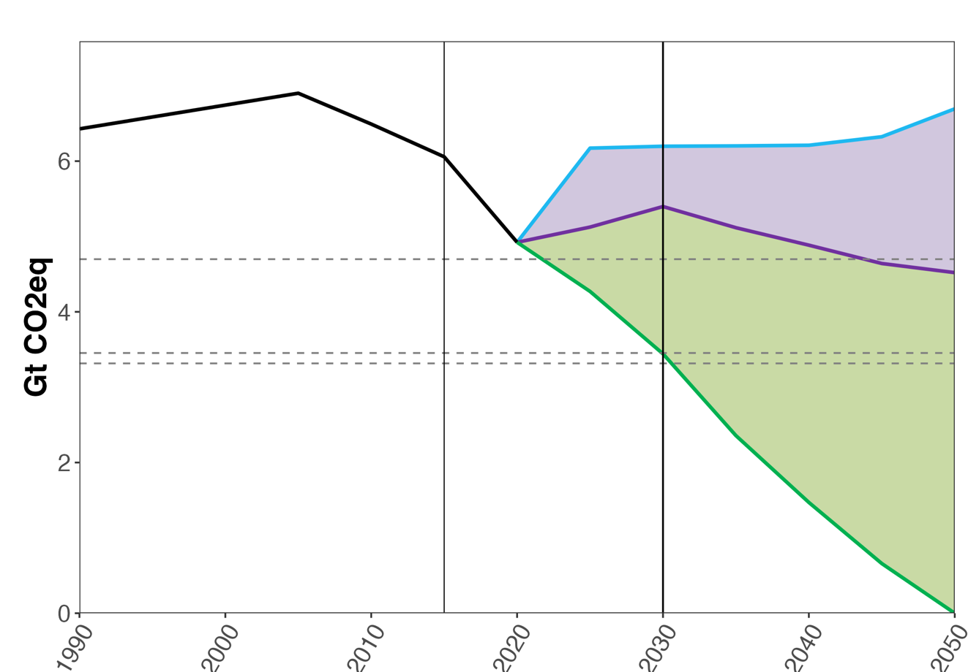
USA – 50-52% net GHG emission reduction below 2005 levels
GHG emissions (Gt CO2e including land use)
PNNL BAU
Rest of the world
Mitigation due to current policy
In the absence of additional climate policy, U.S. GHG emissions are projected to increase again.
U.S. updated NDC target is to reduce its GHG emissions 50-52% below 2005 levels by 2030.
U.S. current policies contribute to emission reductions in 2030
2015 NDC
Brazil
India
2021 NDC 50%
2021 NDC 52%
Mitigation for NDC and net-zero pledge
China
EU
USA

Slide 33
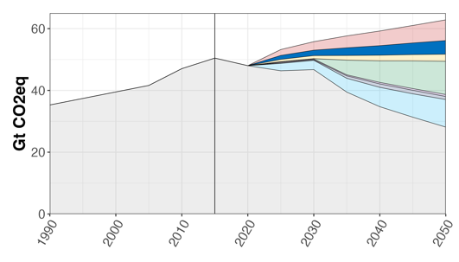
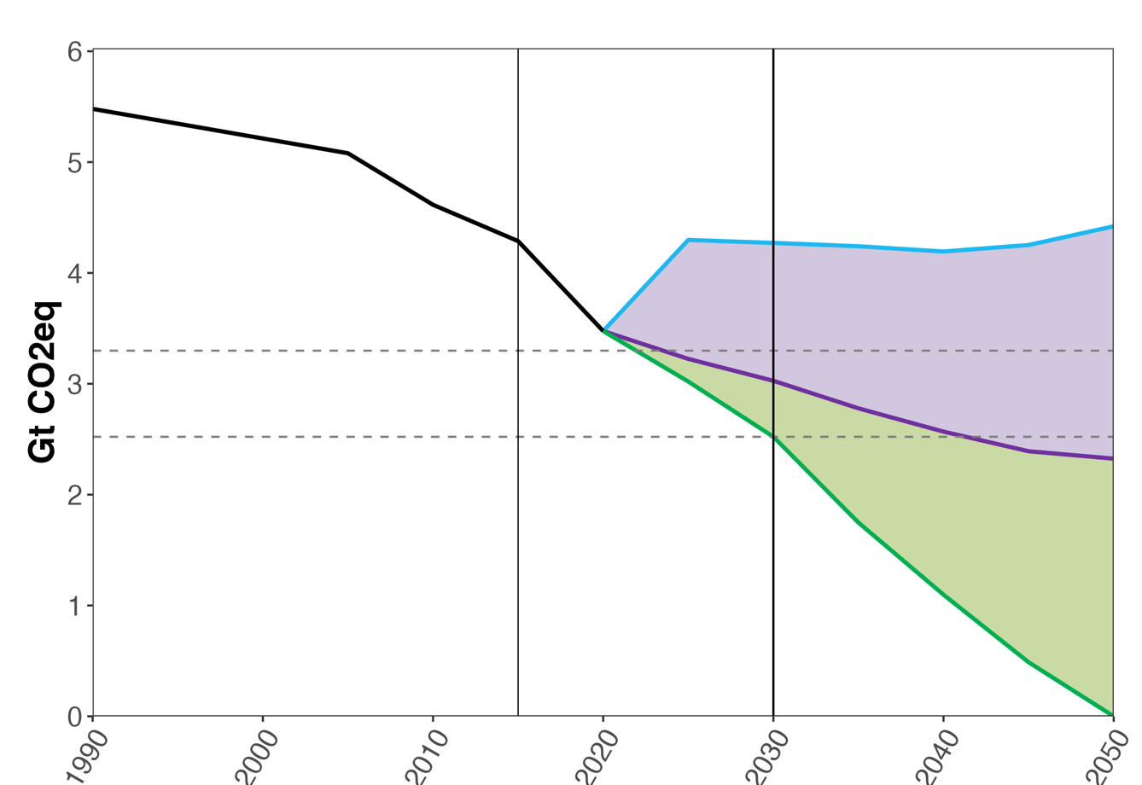
EU – 55% emission reduction below 1990 levels
GHG emissions (Gt CO2e including land use)
Rest of the world
PNNL BAU
In the absence of climate policy, EU’s GHG emissions are projected to slowly increase again.
EU current policy emissions can overachieve its 2015 NDC (40% below 1990).
Meeting the updated 55% target requires additional GHG emissions reduction.
Mitigation due to current policy
Brazil
2015 NDC
India
2021 NDC
Mitigation for NDC and net-zero pledge
China
EU
USA

Slide 34


China – 2030 peak; 60-65% CO2/GDP reduction from 2005
CO₂ emissions (Gt CO2e excluding land use)
60% CO2 / GDP reduction
PNNL BAU
Mitigation due to current policy
Rest of the world
65% CO2 / GDP reduction
China’s CO2 emission is projected to peak on its own in the absence of climate policy.
China’s NDC target: Peak CO2 emissions by 2030 at the latest; Lower CO2 emissions per unit of GDP by 60% to 65% from 2005 levels
PNNL projects emissions between 60-65% CO2 intensity reduction range.
China also pledges a carbon-neutrality goal by 2060, leading to large emission reductions after peaking in 2030.
Brazil
Mitigation for 2060 carbon-neutrality goal
India
China
EU
USA

Slide 35


India – 33-35% emissions/GDP reduction from 2005
GHG emissions (Gt CO2e excluding land use)
Mitigation due to current policy
Rest of the world
Mitigation for NDC
In the absence of climate policy, India’s GHG emissions are projected to increase over time, consistent with historical rate.
India’s NDC includes:
to reduce the emissions intensity of its GDP by 33-35%;
to achieve 40% electric power installed capacity from non-fossil fuels
to create an additional carbon sink of 2.5-5 billion tCO2e
PNNL projects lower emissions in 2030 because of lower reference scenario, which reflects updated assumptions in renewable cost and new technologies.
Climate Action Tracker assessment
Brazil
India
China
EU
USA

Slide 36




We compiled 100+ NDCs, long-term strategies, and net-zero pledges for modeling in GCAM
EU
USA

Slide 37


Global GHG emissions: Reference No New Policy
Historical
Projected
Rest of the world
India
China
Other developed countries:
Canada, Japan, Australia, New Zealand
Other developed countries
EU
USA

Slide 38

Global GHG emissions: Updated Pledges Continued Ambition
Historical
Projected
USA
EU
India
China
Rest of the world
Other developed countries:
Canada, Japan, Australia, New Zealand

Slide 39

Global GHG: remaining emissions
Historical
Projected
Emissions mitigation
Rest of the world
India
China
Other developed countries:
Canada, Japan, Australia, New Zealand
EU
USA

Slide 40

Global GHG emissions: Updated Pledges Increased Ambition
Historical
Projected
Emissions mitigation
Rest of the world
India
Increased mitigation
China
Other developed countries:
Canada, Japan, Australia, New Zealand
EU
USA

Slide 41


*
* Co-lead author

Slide 42
Using GCAM, we constructed emissions pathways. Using a simple climate model (MAGICC) in a probabilistic setup, we evaluated temperature distributions in 2100

Slide 43
Temperature distributions after accounting for pledges submitted during and after COP-21 are improved

Slide 44
Key Takeaways
Collectively, the updated and new 2021 climate pledges are stronger than the 2015 pledges
There’s more than 50% chance that the temperature will remain below 2 degrees if these pledges are implemented as stated
If combined with increased ambition, the probability under 2 degrees can be increased to close to 70%
However, the pledges still fall far short of achieving 1.5 degrees with a reasonable chance

Slide 45





Paris to Glasgow: Improved Pledges vs. Improved Models
< 1.5 °C
< 2.0 °C
> 4.0 °C
We conducted additional simulations combine the emissions scenarios in this study (based on GCAM 5.3) and those from Fawcett et al. 2015 (based on GCAM 4.0) with the versions of MAGICC used in the two studies (MAGICC6 and MAGICC7).
The additional simulations suggest that most of the differences in probabilistic temperature outcomes below 2°C between Fawcett et al. 2015 and this study can be attributed to the updated emissions trajectories, which are in turn driven by the updated pledges, LTSs, net-zero pledges, and other recent societal, policy, and technological trends.
USA

Slide 46





Broad context – increasing details in IAM
Flexible Scale
Regional
Temporal
Sectoral
Current examples
GCAM-USA; GCAM-China; GCAM-Canada; GCAM-India; GCAM-SEAsia; GCAM-LAC; City Scale Modeling
Flexible Time Scale
GCAM Core runs at 5 years; capability to run at one year; ancillary models run at finer scale
Notes:
Sha

Slide 47


Strengths and weaknesses of detailed IAMs compared to global IAMs
Strengths:
Capture regional heterogeneity within a country
Analyze subnational policy / action
Explore interactions between states/provinces
More policy relevant
Weaknesses
Data intensive, more difficult to calibrate
Greater memory requirements
Longer runtime
Solution challenges

Slide 48

Unique features of GCAM-China
Socioeconomics at the provincial level
Population
GDP
Energy transformation at the provincial level
Electricity generation and refining by province
Electricity trade within 6 grid regions
Renewable and carbon storage at provincial level
Wind and solar
Carbon storage
Coal and nuclear power generation at the plant level
Final energy demand at the provincial level
Buildings: commercial, urban residential, and rural residential
Transportation: passenger & freight with detailed technologies
Industry: 9 subsectors

Slide 49

Policies: Renewable deployment in China
NDC: 1200 GW Solar and Wind Capacity by 2030
Minimum provincial non-hydro renewable obligation
(% of generation)
Sources: National Energy Administration, June 2020.
https://www.energypolicy.columbia.edu/research/commentary/trends-and-contradictions-china-s-renewable-energy-policy.

Slide 50

Example: Co-benefits of Air Quality and Climate Policies
With the implementation of the Clean Air Action, PM2.5 exposure in China has been decreased by 32% during 2013-2017 (from 67 ug/m3 to 45 ug/m3), leading to a 14% reduction in premature deaths due to long-term exposure (from 1.2 million in 2013 to 1.0 million in 2017).
Pollution reductions during 2013-2017 were mainly benefited from strict end-of-pipe control measures by the implementation of the Action Plan. The roles of energy-climate policy are positive but minor.
What has worked to reduce emissions and mortality in the past may be less effective in the future.

Slide 51

Example: Model Coupling to Study Health Co-benefits
Source: Liu et al. Under Review

Slide 52

Example: Model Coupling to Study Health Co-benefits
Source: Liu et al. Under Review

Slide 53

Example: Finding Feasible Coal Phaseout Pathways
Source: Cui et al. 2021.

Slide 54


GCAM-USA
GCAM: Global Change Assessment Model
Integrated Assessment Model of Economic, Energy, Land-use, Water, Emissions and Climate systems
Modeling of future emissions scenarios to 2100
Emissions of 16 greenhouse gases and short-lived species
GCAM is an open-source community model
GCAM-USA is a version of GCAM with state-level detail in the United States.
The 50-state version is embedded within the global version of GCAM.
It is actively being used to explore energy-water-land interactions and conduct policy analysis

Slide 55

Subnational actors in climate mitigation
Hultman, N.E., Clarke, L., Frisch, C. et al. Fusing subnational with national climate action is central to decarbonization: the case of the United States. Nat Commun 11, 5255 (2020). https://doi.org/10.1038/s41467-020-18903-w. Fig. 1.

Slide 56
Modeled Scenarios
Existing Policies
Includes current subnational measures (below) and major climate provisions from IIJA and IRA
IIJA investments in transportation infrastructure
IRA investments in clean energy, energy efficiency, methane fee in oil and gas sector.
State and local-level renewable portfolio standards and RE targets, building efficiency targets, transportation sales targets
Projected market forces and other existing policies a cross all sectors (i.e. Corporate Average Fuel Economy standards)
Beyond 50
Layers on federal and non-federal policies across all sectors that achieve the 50-52% reductions needed to meet the NDC
Existing policies
Enhanced fuel efficiency standards
Methane fee across all sectors
Coal phaseout
CCS requirement for new gas
Heightened renewable portfolio standards and RE targets, building efficiency targets, transportation sales targets
Enhanced electrification for buildings and industry sectors through gas bans and buy clean policies

Slide 57

Emissions reductions under an “all-in” climate pathway to achieve the U.S. climate target by 2030
The existing policies scenario shows a majority of reductions from the energy and transportation sectors, with significant additional reductions from methane, largely driven by IRA, can achieve 39% reductions by 2030 from 2005 levels with potential for 42% reductions with accelerated implementation.
The Beyond 50 scenario incorporates the climate-smart application of IRA from primarily states, with an all-of-society, accelerated approach to a national climate strategy and shows a pathway for the United States to achieve 52% emissions reductions from 2005 levels by 2030.

Slide 58

Transport sector results
Existing policies achieves significant electrification for passenger cars
IIJA investment in transport infrastructure and bus electrification
IRA EV tax credits
Corporate Average Fuel Economy (CAFE) standards
State-level ZEV sales targets
Beyond 50 strengthens electrification for buses and freight trucks
Heightened state-level ZEV sales targets
100% bus electrification
Vehicle miles traveled reduction policies
Improved CAFE standards

Slide 59

Transport report shows contribution of federal and non-federal actors to achieve NDC
Transportation emissions need to decrease by 34% to meet the NDC
Current Measures reduce emissions by 350 MtCO₂ (19%)
Remaining 15% must come from non-federal and federal actors
Non-federal action: 92 MtCO₂ (5%)
Congressional EV tax credit: 55 MtCO₂ (3%)
Additional federal actions: 120 MtCO₂ (7%)
97% of reductions occur in light-duty and heavy-duty vehicles
Zhao, A., McJeon, H., Cui, R., Cyrs, T., Feldmann, J., Iyer, G., Kathleen Kennedy, Kevin Kennedy, S. Kennedy, O’Keefe, K., Rajpurohit, S., Rowland, L., & Hultman, N. (2022). An “All-In” pathway to 2030: Transportation sector emissions reduction potential. Center for Global Sustainability, University of Maryland and America Is All In. Available at www.AmericaIsAllIn.com. 8pp.

Slide 60

Power sector results
Existing policies reaches 71% clean electricity by 2030.
IRA tax credits for renewables, CCS, hydrogen
Energy Investment Refinancing program
State- and city-level renewable energy targets
Beyond 50 reaches 80% clean electricity by 2030
Coal phaseout
More ambitious state- and city-level renewable energy targets

Slide 61

Methane sector results
Existing policies achieves 10% reductions in methane emissions from 2020 levels
IRA oil and gas methane fee
IRA methane-specific agriculture provisions
Beyond 50 achieves over 30% reductions
Methane fee across all sectors
Strengthened EPA regulations on oil and gas methane
State-level standards on existing and new oil and gas sources, emissions standards in the agriculture sector and implementation of agricultural mitigation strategies , waste- reduction policies

Slide 62

Methane report shows contribution of federal and non-federal actors to achieve NDC
Non-federal action achieves nearly 16% methane emissions reductions below 2020 levels by 2030
With federal action, we can achieve over 30%
Zhao, A., K. O’Keefe, H. McJeon, K. Clark-Sutton, R. Cui, J. Feldmann, Kathleen Kennedy, Kevin Kennedy, S. Kennedy, J. Meisel, D. Nilov, S. Rajpurohit, N. Hultman (2022). “An ‘All-In’ Pathway To 2030: U.S. Methane Sector Emissions Reduction Potential.” Center for Global Sustainability, University of Maryland and America Is All In. 16 pp.

Slide 63



Power
Transport
Methane

Slide 64

Sectoral reductions to get to 52%
As of today, the U.S. has achieved 21% in reductions
From today’s levels, power sector contributes an additional 16%, transport sector contributes 5%, and methane sector contributes 3%.
Industry, buildings, lands, and other sectors contribute the remaining 5%
Notes:
SAMPLE SLIDE +++++
DUPLICATE THIS SLIDE FOR THE NUMBER OF THIS TYPE YOU WILL NEED – ALWAYS HAVE ONE EXTRA
CHANGE HEADLINE OR SUBHEAD TEXT COLOR: Highlight text. Choose FORMAT SHAPE, then TEXT OPTIONS, then the first A. Keep black for the body text.

Slide 65

US Model Comparison Study
Presented by Haewon McJeon

Slide 66






Comparison of Participating Energy Systems Models
Abbr. | Model(s) | Institution | 2030 Emissions | Policies Assumed | Study
EDF-NEMS | RHG-NEMS | EDF | 51% net GHG reduction from 2005 | Suite of sector-specific policies and economy-wide limit on energy CO₂ | Link
GCAM-USA-AP | GCAM-USA-AP | PNNL, CGS | 50% net GHG reduction from 2005 | Bottom-up, sector-specific suite of policies and incentives | Link
LBNL | FACT (transport), ReEDS+PLEXOS (power), EPS (other sectors) | UCB (FACT), NREL (ReEDS), Energy Innovation (EPS) | 50% GHG reduction from 2005 | 80% federal CES and no new gas in power sector 100% EV mandates for light-duty and 80% medium-/heavy-duty Building elec. mandates CH₄/F-gas reductions | Link
PATHWAYS | RIO (supply-side), EnergyPATHWAYS (demand-side) | Evolved Energy Research | 53% net GHG reduction from 2005 | State and federal policies on the books as of Q3 2020 | Link
REGEN | US-REGEN | EPRI | 50% net GHG reduction from 2005 | Economy-wide CO₂ cap by 2030 2035 electric sector net-zero target | Link
USREP-ReEDS | USREP-ReEDS | MIT, NREL | 50% CO₂ reduction from 2005 | EE mandates 50% CO₂ cap by 2030 | Link
Multi-model studies identify which insights are robust and which differ across models
Models assume different policy pathways to reach the 2030 target

Slide 67

Working list of policies…
After the publication of the comparison paper, many new climate policies were enacted.
We’re continuously updating the policies to assess the emission impacts.

Slide 68
Results: Sectoral Reductions to Reach 50x30 Targets
Notes
Bulk of reductions to reach 2030 target come from the electric sector and transport (~70-90% of 2030 reductions)
All sectors are involved to varying degrees: Halving GHGs is an “all-hands-on-deck” situation requiring many technology and policy tools
Electric
Industry
Buildings
Transport
Other CO₂
Non-CO₂ GHGs
Land
Source: Bistline, et al. (2022), “Actions for Reducing U.S. Emissions at Least 50% by 2030”

Slide 69
What Could It Take? Rapid Buildout of the Grid
Average build rate in scenario reaching 80% electric CO₂ reduction by 2030
Storage
Solar
Wind
Gas CCS
Gas
Coal
Other
Hydro
Nuclear
LBNL
REGEN
EDF-NEMS
PATHWAYS
REGEN E+
GCAM-USA-AP
USREP-ReEDS
Average Build Rate to 2030
Historical maximum additions exceeded each year through 2030, but mix varies across models

Slide 70
What Could It Take? Extensive Electric Vehicle Adoption
LBNL
USREP-ReEDS
REGEN E+
GCAM-USA-AP
Biden 2030 target
PATHWAYS
Range
REGEN
EDF-NEMS
Average
50x30
Reference
EVs projected to reach 34-100% of new sales—10-25x current levels—which is much higher than with current policies and technology trends (i.e., “Reference” scenario)

